Slide 1
Understanding and Navigating
The Criminal Justice System
Presentation for Guardianship Conference
Carolina Beach
4 May 2023
Robert Ward, Attorney
Kristin Parker, Paralegal
Public Defender’s Office
Charlotte, NC

Slide 2
Realities for all of us – in our communities and in our homes:
A significant number of people are suffering from aging, grief, loss, mental illnesses, addiction, learning disabilities, and other significant visible and invisible disabilities requiring substitutional decision making and guardianships;
COVID and the economic malaise contribute to an increase in requests for aid from churches, government and private sector agencies, etc.;
Designing, implementing and maintaining a more disciplined self/family management approach can be problematic and draining;
These personal and familial crisis – acute or chronic - account for much pain, suffering, and use of resources (e.g., time, energy, goods, services, finances), and can involve the criminal justice system

Slide 3
What we do in court…
Receive the accused
Involve the adversarial legal professionals
Marshall evidence and rules
Negotiate dispositions
Rarely engage trial process
85% get probation, some get jail and prison
Probation supervises and refers to services
Probation violations treated as mini-crimes
Arbitrary continuation or revocation

Slide 4



Slide 6
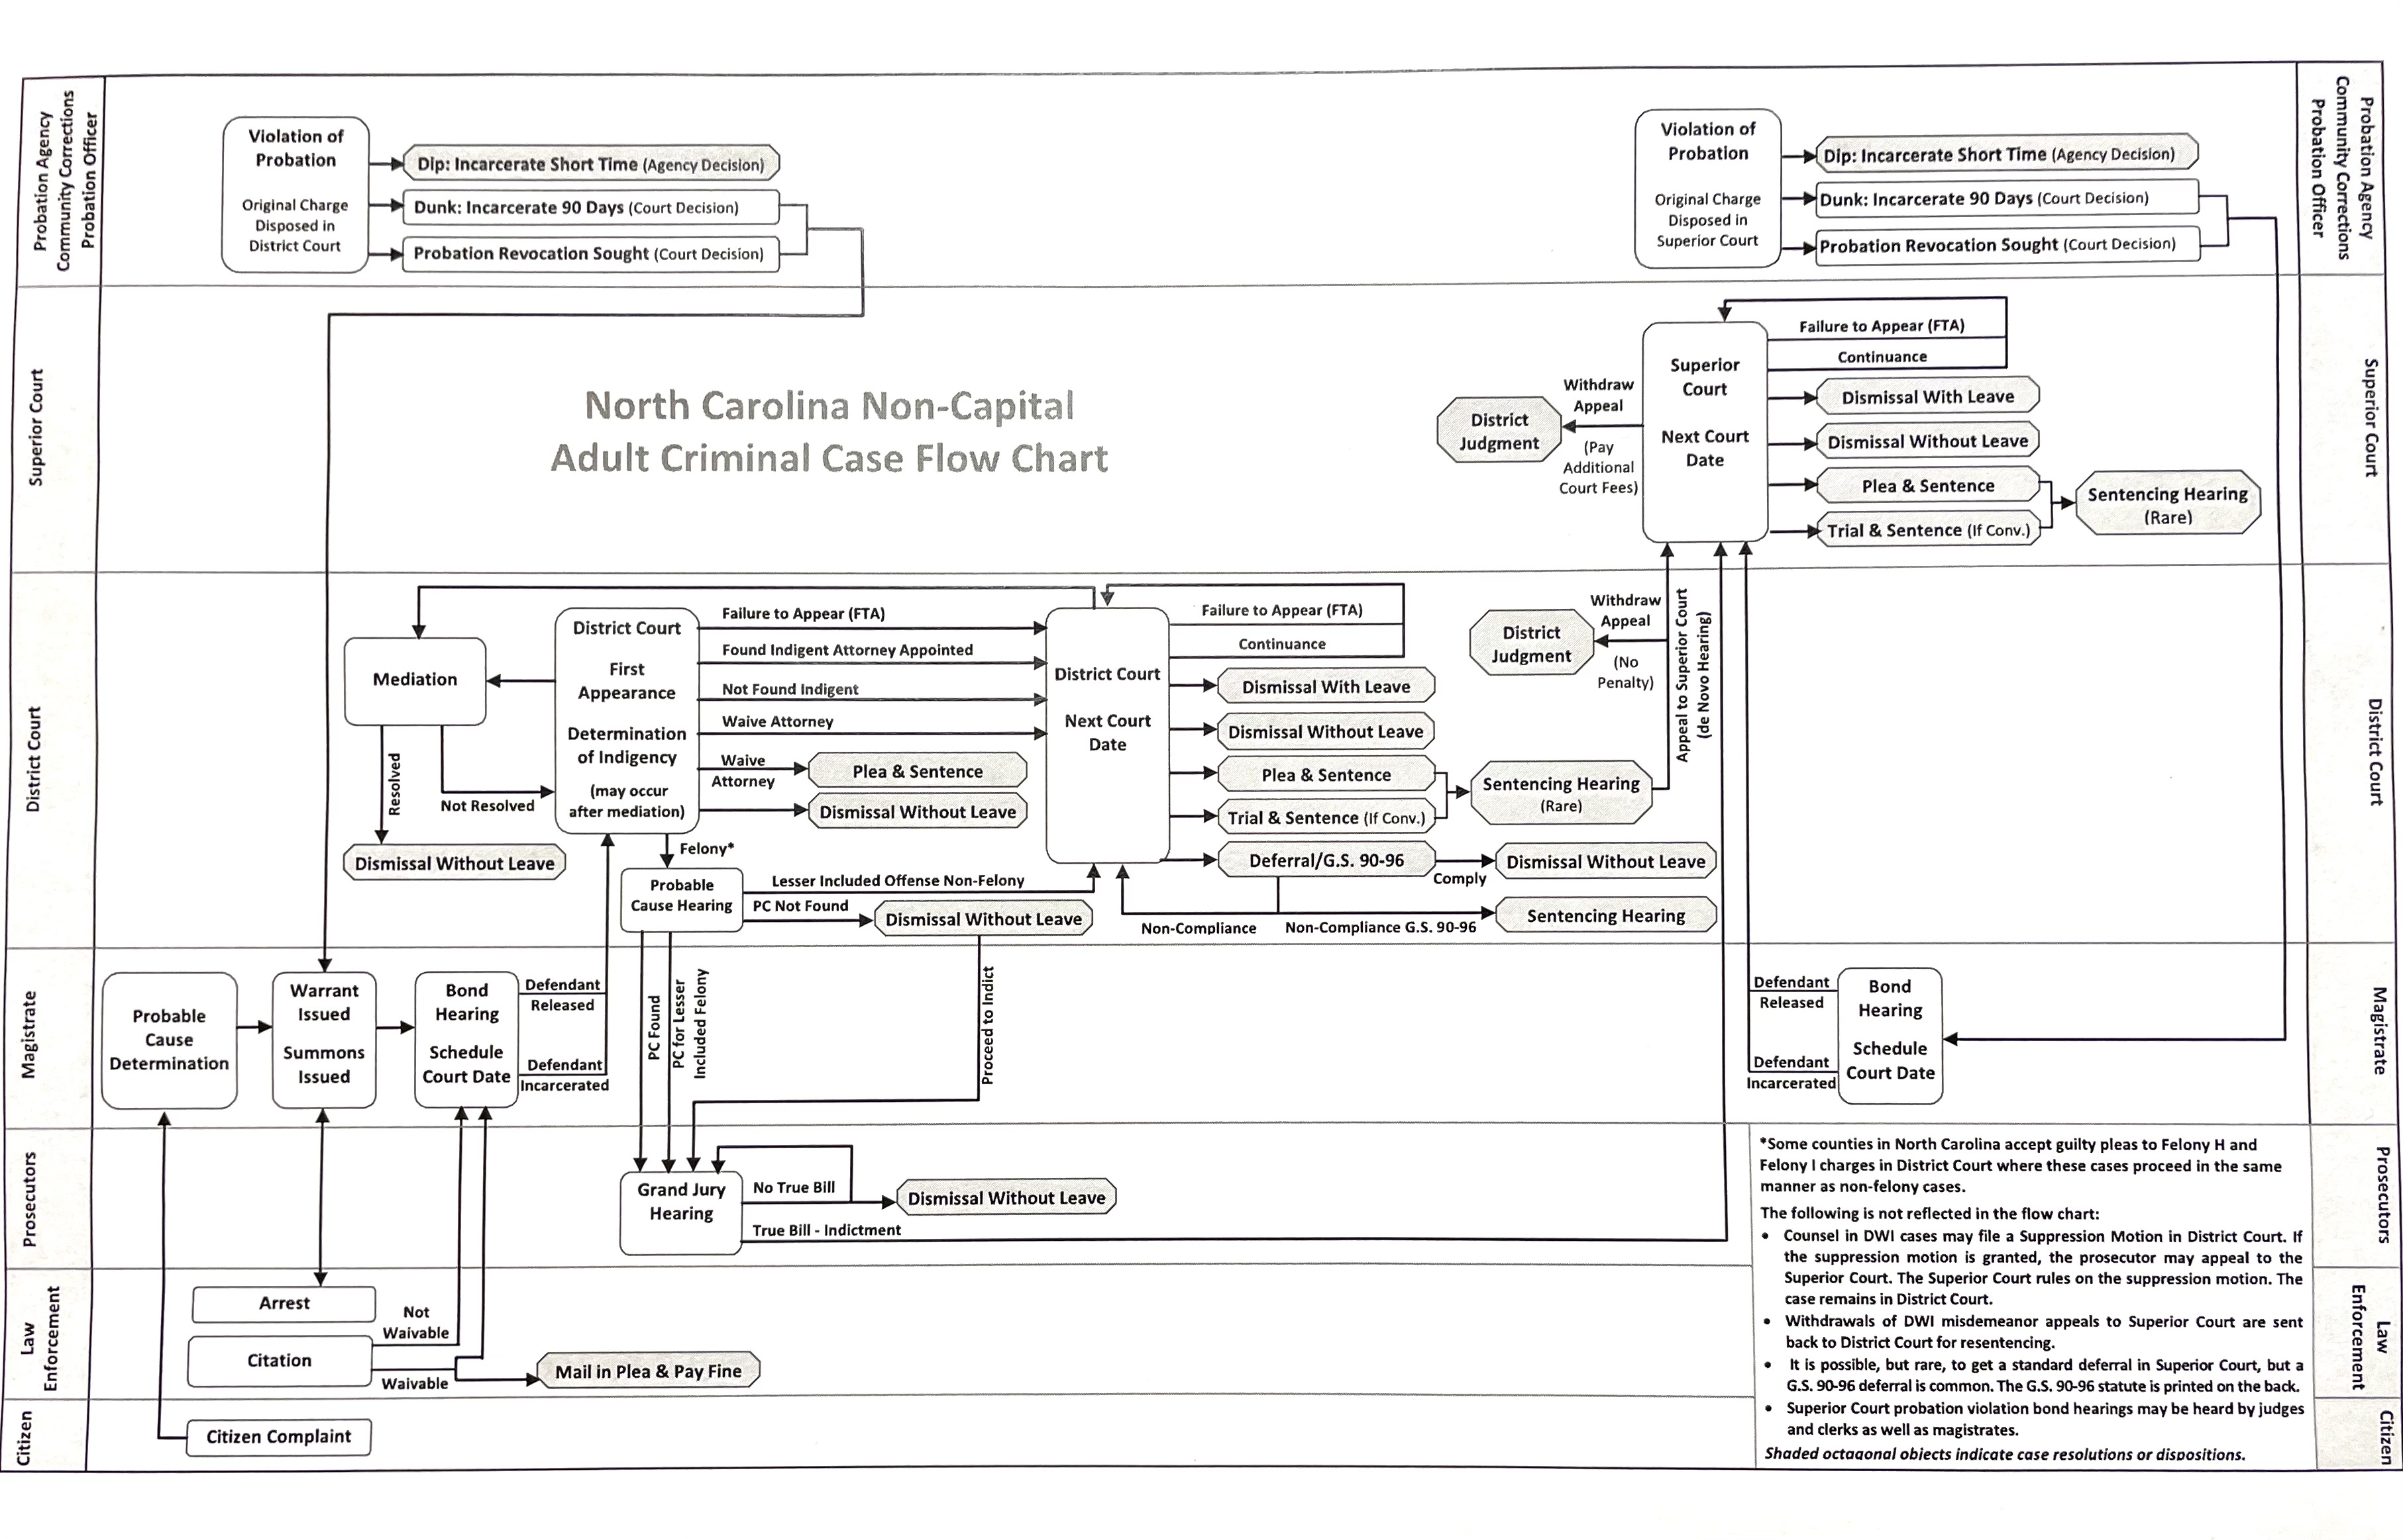

Slide 7
States of Mind:
Intentionally
General Intent and Specific Intent
Transferred Intent
Knowingly
Subjective
Objective
Willfully
Maliciously
Criminal Negligence
Strict Liability
Bars and Defenses:
Double Jeopardy
Lack of Jurisdiction
State-Granted Immunity
Self Defense, Defense of Others and Property
Necessity and Duress

Slide 8
Due Process and Constitutional Rights
Right to Counsel
Right Against Self-Incrimination
Right Against Unlawful Search and Seizure
Arrest and Investigative Stops
Search and Seizure
Search Warrants
Rules of Evidence
Relevance
Witness Competency
Best Evidence
Expert Opinion
Hearsay
Criminal Trial Procedure
Motions to Suppress
Beyond a Reasonable Doubt
Physical and Demonstrative Evidence
Jury Instructions

Slide 9
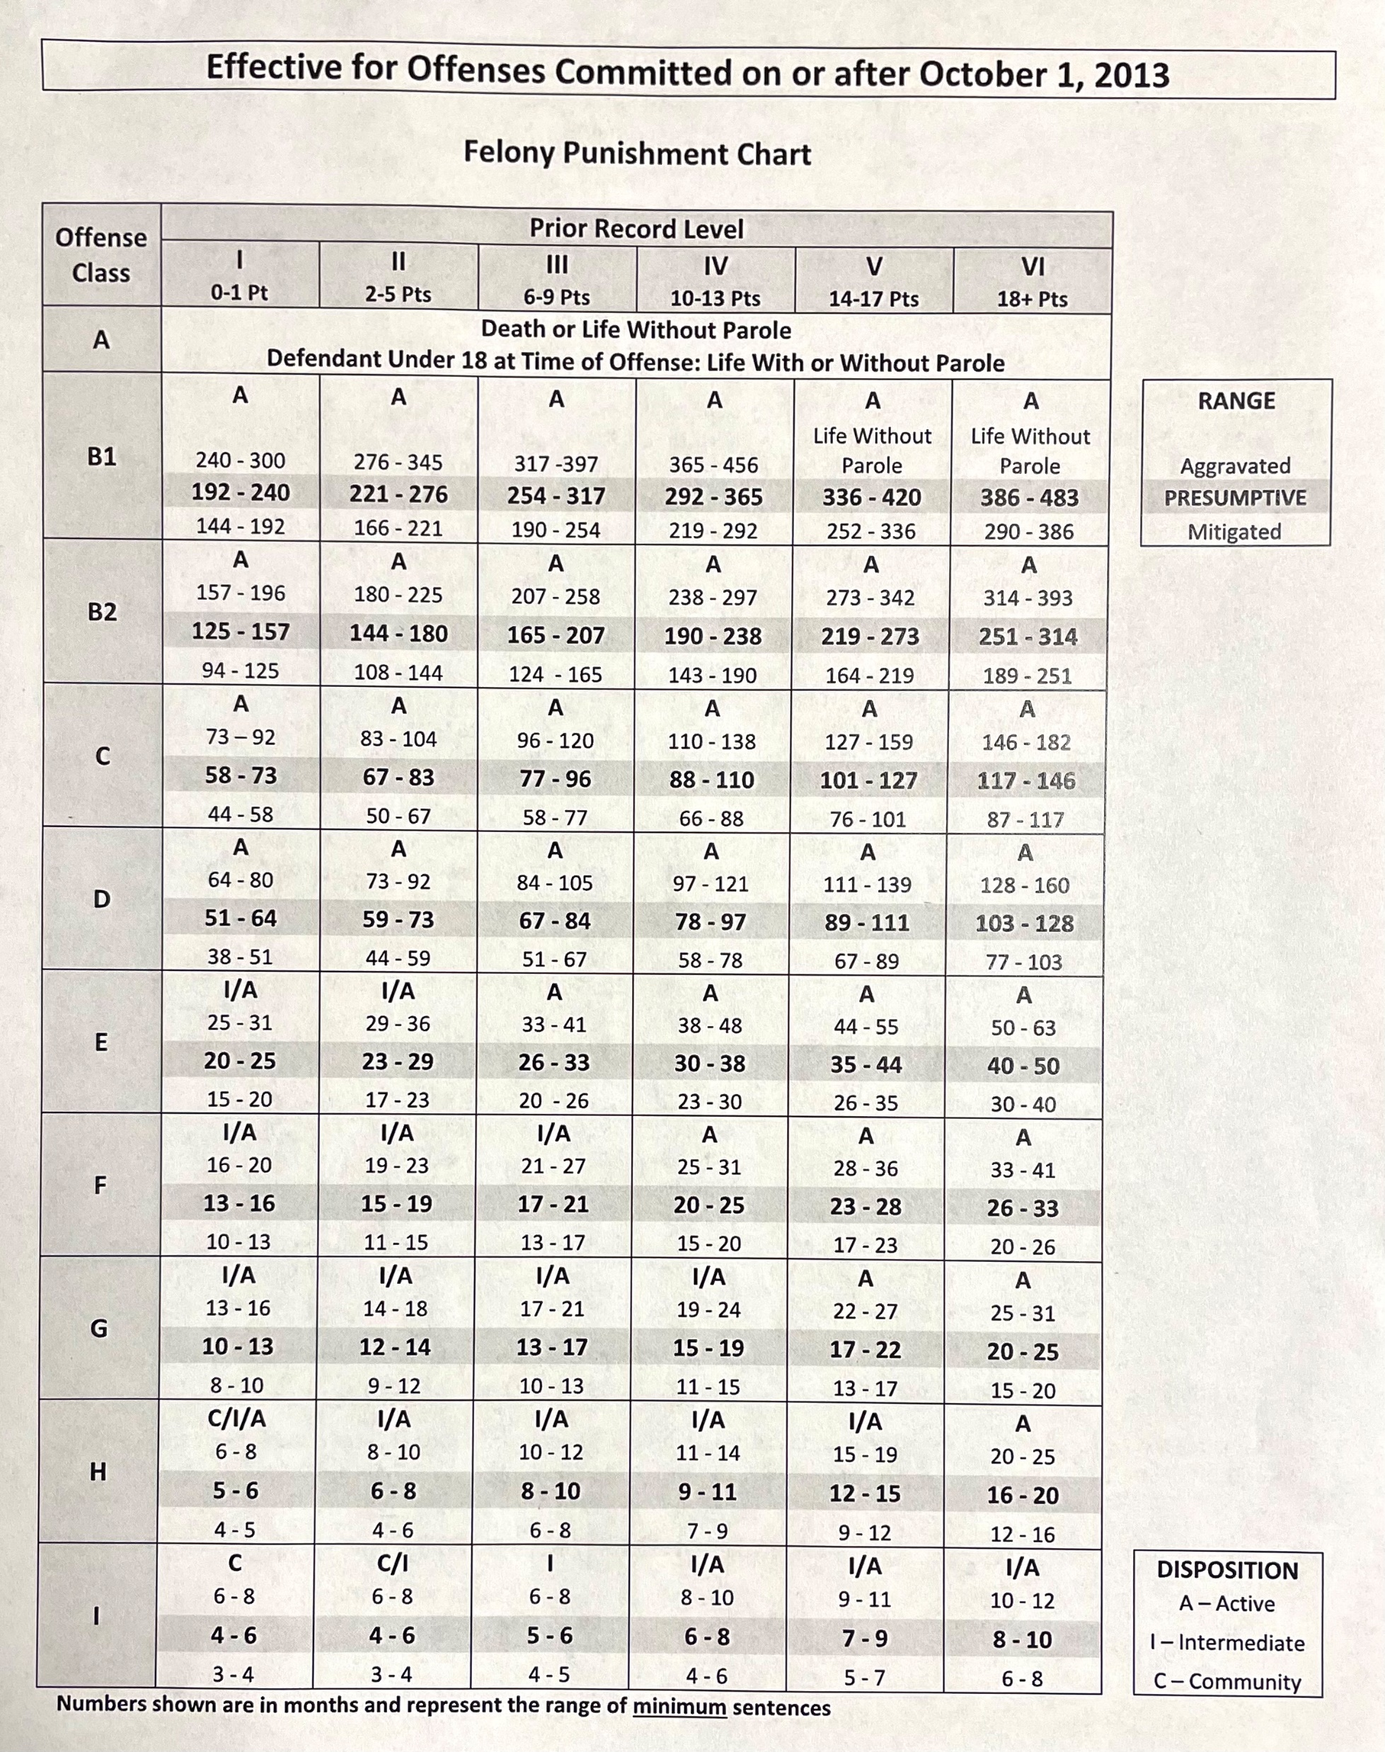

Slide 10
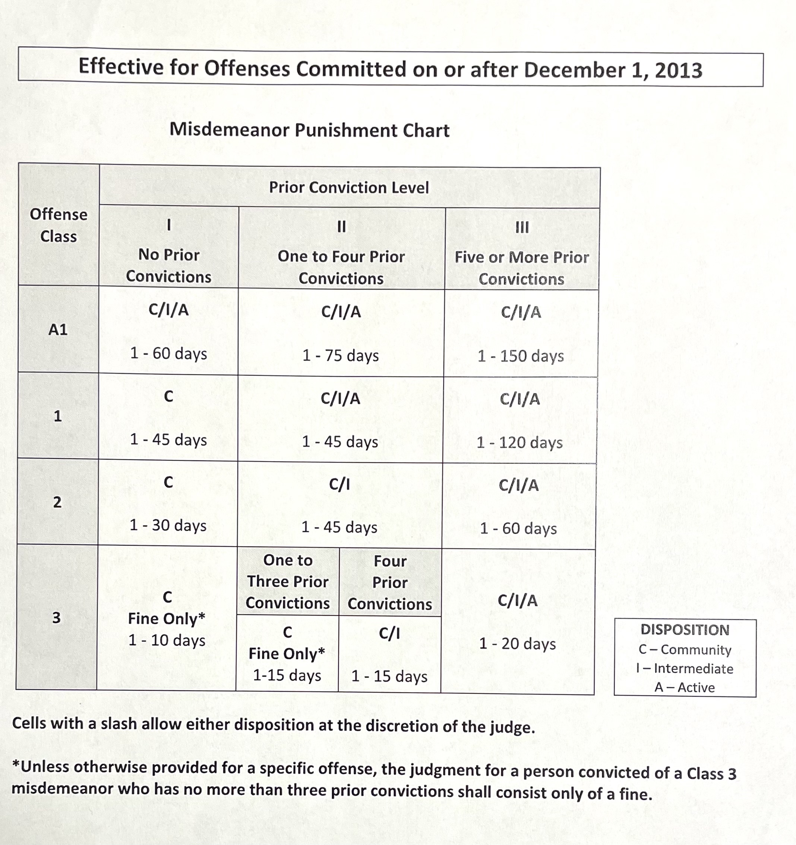

Slide 11
Aggravating Factors for Sentencing – North Carolina
15A-1340.16:
(d) Aggravating Factors. – The following are aggravating factors:
(1) The defendant induced others to participate in the commission of the offense or occupied a position of leadership or dominance of other participants.
(2) The defendant joined with more than one other person in committing the offense and was not charged with committing a conspiracy.
(2a) The offense was committed for the benefit of, or at the direction of, any criminal gang as defined by G.S. 14-50.16A(1), with the specific intent to promote, further, or assist in any criminal conduct by gang members, and the defendant was not charged with committing a conspiracy.
(3) The offense was committed for the purpose of avoiding or preventing a lawful arrest or effecting an escape from custody.
(4) The defendant was hired or paid to commit the offense.

Slide 12
(5) The offense was committed to disrupt or hinder the lawful exercise of any governmental function or the enforcement of laws.
(6) The offense was committed against or proximately caused serious injury to a present or former law enforcement officer, employee of the Department of Public Safety or the Department of Adult Correction, jailer, fireman, emergency medical technician, ambulance attendant, social worker, justice or judge, clerk or assistant or deputy clerk of court, magistrate, prosecutor, juror, or witness against the defendant, while engaged in the performance of that person's official duties or because of the exercise of that person's official duties.
(6a) The offense was committed against or proximately caused serious harm as defined in G.S. 14-163.1 or death to a law enforcement agency animal, an assistance animal, or a search and rescue animal as defined in G.S. 14-163.1, while engaged in the performance of the animal's official duties.
(7) The offense was especially heinous, atrocious, or cruel.
(8) The defendant knowingly created a great risk of death to more than one person by means of a weapon or device which would normally be hazardous to the lives of more than one person. G.S. 15A-1340.16 Page 3

Slide 13
(9) The defendant held public elected or appointed office or public employment at the time of the offense and the offense directly related to the conduct of the office or employment.
(9a) The defendant is a firefighter or rescue squad worker, and the offense is directly related to service as a firefighter or rescue squad worker.
(10) The defendant was armed with or used a deadly weapon at the time of the crime.
(11) The victim was very young, or very old, or mentally or physically infirm, or handicapped.
(12) The defendant committed the offense while on pretrial release on another charge.
(12a) The defendant has, during the 10-year period prior to the commission of the offense for which the defendant is being sentenced, been found by a court of this State to be in willful violation of the conditions of probation imposed pursuant to a suspended sentence or been found by the Post-Release Supervision and Parole Commission to be in willful violation of a condition of parole or post-release supervision imposed pursuant to release from incarceration.
(13) The defendant involved a person under the age of 16 in the commission of the crime.
(13a) The defendant committed an offense and knew or reasonably should have known that a person under the age of 18 who was not involved in the commission of the offense was in a position to see or hear the offense.

Slide 14
(14) The offense involved an attempted or actual taking of property of great monetary value or damage causing great monetary loss, or the offense involved an unusually large quantity of contraband.
(15) The defendant took advantage of a position of trust or confidence, including a domestic relationship, to commit the offense.
(16) The offense involved the sale or delivery of a controlled substance to a minor.
(16a) The offense is the manufacture of methamphetamine and was committed where a person under the age of 18 lives, was present, or was otherwise endangered by exposure to the drug, its ingredients, its by-products, or its waste.
(16b) The offense is the manufacture of methamphetamine and was committed in a dwelling that is one of four or more contiguous dwellings.
(17) The offense for which the defendant stands convicted was committed against a victim because of the victim's race, color, religion, nationality, or country of origin.

Slide 15
(18) The defendant does not support the defendant's family.
(18a) The defendant has previously been adjudicated delinquent for an offense that would be a Class A, B1, B2, C, D, or E felony if committed by an adult.
(19) The serious injury inflicted upon the victim is permanent and debilitating.
(19a) The offense is a violation of G.S. 14-43.11 (human trafficking), G.S. 14-43.12 (involuntary servitude), or G.S. 14-43.13 (sexual servitude) and involved multiple victims.
(19b) The offense is a violation of G.S. 14-43.11 (human trafficking), G.S. 14-43.12 (involuntary servitude), or G.S. 14-43.13 (sexual servitude), and the victim suffered serious injury as a result of the offense.
(20) Any other aggravating factor reasonably related to the purposes of sentencing.

Slide 16
Mitigating Factors – Structured Sentencing
(e) Mitigating Factors. – The following are mitigating factors:
(1) The defendant committed the offense under duress, coercion, threat, or compulsion that was insufficient to constitute a defense but significantly reduced the defendant's culpability.
(2) The defendant was a passive participant or played a minor role in the commission of the offense.
(3) The defendant was suffering from a mental or physical condition that was insufficient to constitute a defense but significantly reduced the defendant's culpability for the offense.
(4) The defendant's age, immaturity, or limited mental capacity at the time of commission of the offense significantly reduced the defendant's culpability for the offense.
(5) The defendant has made substantial or full restitution to the victim.
(6) The victim was more than 16 years of age and was a voluntary participant in the defendant's conduct or consented to it.
(7) The defendant aided in the apprehension of another felon or testified truthfully on behalf of the prosecution in another prosecution of a felony.

Slide 17
(8) The defendant acted under strong provocation, or the relationship between the defendant and the victim was otherwise extenuating.
(9) The defendant could not reasonably foresee that the defendant's conduct would cause or threaten serious bodily harm or fear, or the defendant exercised caution to avoid such consequences.
(10) The defendant reasonably believed that the defendant's conduct was legal.
(11) Prior to arrest or at an early stage of the criminal process, the defendant voluntarily acknowledged wrongdoing in connection with the offense to a law enforcement officer.
(12) The defendant has been a person of good character or has had a good reputation in the community in which the defendant lives.
(13) The defendant is a minor and has reliable supervision available.
(14) The defendant has been honorably discharged from the Armed Forces of the United States.
(15) The defendant has accepted responsibility for the defendant's criminal conduct.

Slide 18
(16) The defendant has entered and is currently involved in or has successfully completed either (i) a drug treatment program, (ii) an alcohol treatment program, or (iii) a mental, behavioral, or medical health-related treatment program, subsequent to arrest and prior to trial.
(17) The defendant supports the defendant's family.
(18) The defendant has a support system in the community.
(19) The defendant has a positive employment history or is gainfully employed. G.S. 15A-1340.16 Page 5
(20) The defendant has a good treatment prognosis, and a workable treatment plan is available.
(21) Any other mitigating factor reasonably related to the purposes of sentences.

Slide 19
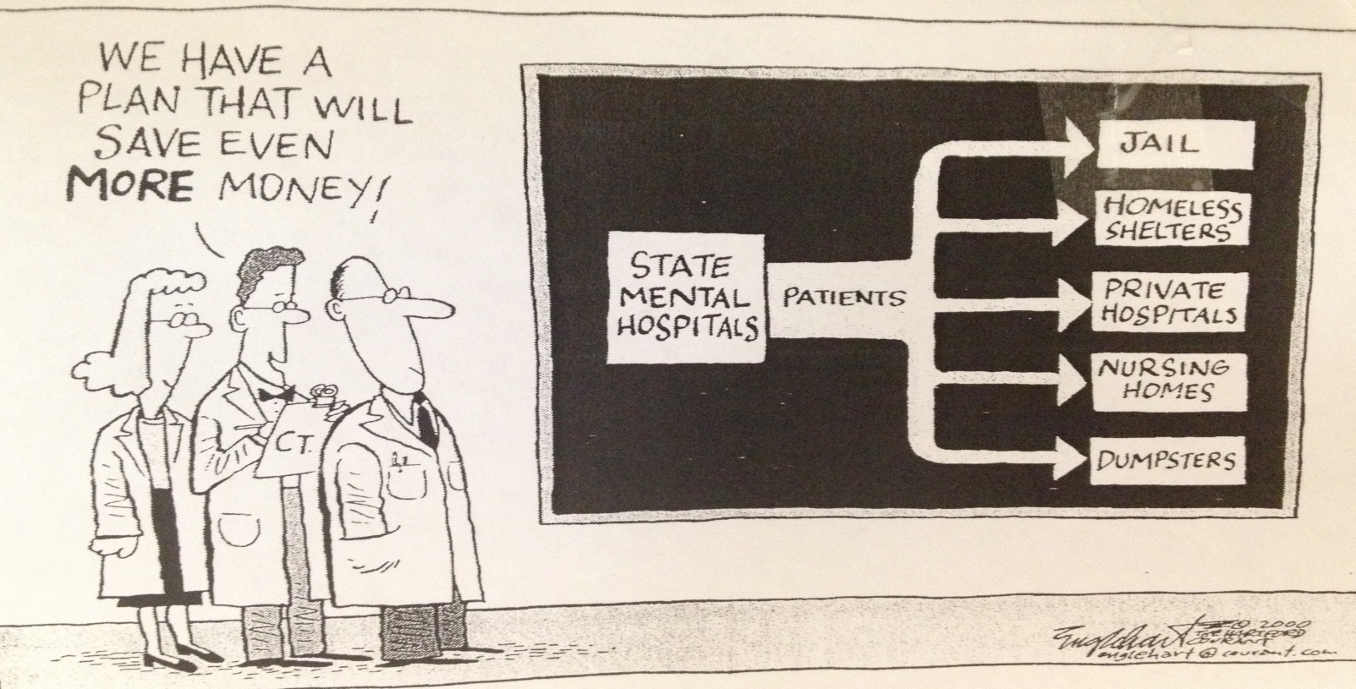
“Facts are Stubborn Things”
John Adams, Lawyer and 2nd U.S. President
The current reality right now is that like it or not, one “stubborn fact” is that we are all essentially mental health care first responders and long term community support providers without truly realizing it, and without reasonably comprehensive adequate training, or support - with these results:

Slide 20

How Do We Frame the Story of the People and the Situation?
Professionals and those involved in the criminal justice system face two basic approaches for case disposition – The first approach asks, “is this a bad person needing to be good?” and the second asks, “is this a sick person needing to get well?” If a defendant were you or someone you loved which question would you ask? Which would you want the justice system to ask?

Slide 21
The Criminal Justice System – A limited and complex process
The primary focus is public safety and the crime control model, with rehabilitation running a distant second in priority and opportunities.
The justice system does have great success with certain limited programs, like treatment courts, but the volume of people coming through the system is overwhelming, and criminal records create greater barriers with housing, employment, education, transportation and medical care.
The justice system can be overly strict and overly lenient at the same time.
The lack of sympathy, awareness and understanding of mental health issues is widespread.
Those with information and a plan ahead of time are much better off than those without, and diversion or mitigation is much more likely for those who are prepared.
A psychiatric advance directive and health care power of attorney could help someone avoid arrest, conviction, greater punishment, or greater suffering while in the criminal or civil justice system

Slide 22
The Civil Commitment System – An Alternative to the Criminal Justice System
It wasn’t designed for today’s reality.
Only those who’ve been through it a few times know how it does and does not work.
The two conditions for Commitment Orders are having an acute case of mental illness that results in being a danger to self, to others or to serious health deterioration.
The Judgments are the functional equivalent to a temporary health care power of attorney that allows a facility to lock the doors, transport and force medications on people.
Any outpatient treatment orders are only as good as the provider and jurisdiction that supports them. In Mecklenburg County they’ve been marginally enforced at best. The patients and families learn this rather quickly after the first commitment.

Slide 23
At The Public Defender’s Office
We represent our fellow citizens, neighbors and family members who face:
Criminal trials, appeals and other court proceedings;
Civil involuntary commitment proceedings.
Key questions for us to answer using a rehabilitative approach in a punitive world:
What happened?
Why did it happen?
What are the present and long-term options?
What are we going to do about it?

Slide 24
Possible Issues to Address:
1. Mental Health, Dementia, Learning Disabilities, Death, Other Illnesses, Joblessness, Loss, Substance abuse and Co-Dependency are just some of the serious and complex needs presented to individuals, families, friends, etc.;
2. Family, friends, or associates can be over-utilized or under-utilized under the current process;
3. It might help to focus adequate specialized attention more wisely and demonstrably;
4. Most people and families can experience a sense of futility in dealing with individuals who have special and multiple needs;
5. There is a lack of easily accessible, available, or low-cost treatment for many people in our community;
6. Better information-sharing to, from, and among individuals and organizations is needed in order to establish and maintain an accessible and effective continuum of services;
7. Individuals and families do have opportunities to innovate and improve their planning and responses to acute and chronic care situations.

Slide 25
Much of criminal defense work is Advocacy for Mitigation and Rehabilitation, all of which are consistent with finding or following a recovery model: Opportunities Found: Referring a client to an appropriate treatment (a.k.a. “medical”) resource can be the first step of a client’s defense and the resolution of the criminal case by: 1. Providing the client with the opportunity for rehabilitation and recovery;
2. Providing the Prosecutor, Judge, and Corrections with a perspective and plan for a successful case disposition and community outcome. Opportunities Lost: Fragmentation of treatment and other services is a barrier for adequately addressing underlying problems, hindering the ability for all criminal justice professionals to be fully effective in their respective roles.

Slide 26
Four Convergent Movements in Law Regarding Behavioral Heath,
Individuals, Families and Our Communities:
Therapeutic Jurisprudence: Late ’70s - Two Law Professors Begin a Conversation
David Wexler
Bruce Winnick
Drug Treatment Courts: Late ’80s - Seeking Legitimacy in Legal Theory
Judge Peggy Hora
Judge Bill Schma
Structured Sentencing and Alternatives to Incarceration: Late 80’s – Realizing they’re coming home
Civil Commitments – Competency, Commitment and Supportive Services
Mitigation Plans
Prison Reform and Alternatives to Incarceration
Justice Reinvestment Act
Legal Ethics, Lawyer Assistance Programs, and Lawyer Competency:
Late 80’s Addressing visible and invisible disabilities of clients and colleagues

Slide 27
Therapeutic Jurisprudence – A Definition
“Therapeutic jurisprudence is the ‘study of the role of the law as a therapeutic agent’. It focuses on the law’s impact on emotional life and on psychological well-being. These are areas that have not received very much attention in the law until now….Basically, therapeutic jurisprudence is a perspective that regards the law as a social force that produces behaviors and consequences. Sometimes these consequences fall within the realm of what we call therapeutic; other times antitherapeutic consequences are produced. Therapeutic jurisprudence wants us to be aware of this and wants us to see whether the law can be made or applied in a more therapeutic way so long as other values, such as justice and due process, can be fully respected.” David Wexler, Rehabilitating Lawyers, p.3-4.

Slide 28
Ethics: Duties and Responsibilities, Capabilities and Compliance
NC Bar Preamble: Improving the System of Justice and Society
Ethics Rule 1.14: Clients with Diminished Capacity
Ethics Rule 2.1: The Lawyer as Advisor
ABA Commission on Mental and Physical Disability Law
NC LAP and LAMP

Slide 29
N. C. Bar Client-Lawyer Relationship: Rule 1.14 Client with Diminished Capacity
(a) When a client's capacity to make adequately considered decisions in connection with a representation is diminished, whether because of minority, mental impairment or for some other reason, the lawyer shall, as far as reasonably possible, maintain a normal client-lawyer relationship with the client. (b) When the lawyer reasonably believes that the client has diminished capacity, is at risk of substantial physical, financial or other harm unless action is taken and cannot adequately act in the client's own interest, the lawyer may take reasonably necessary protective action, including consulting with individuals or entities that have the ability to take action to protect the client and, in appropriate cases, seeking the appointment of a guardian ad litem or guardian. (c) Information relating to the representation of a client with diminished capacity is protected by Rule 1.6. When taking protective action pursuant to paragraph (b), the lawyer is impliedly authorized under Rule 1.6(a) to reveal information about the client, but only to the extent reasonably necessary to protect the client's interests.

Slide 30
Rule 2.1 Advisor
“In representing a client, a lawyer shall exercise
independent
professional judgment and
render candid advice.”

Slide 31
Rule 2.1 Other Considerations In rendering advice, a lawyer may refer not only to law, but also to other considerations such as moral, economic, social, and political factors that may be relevant to the client's situation. Therefore, many attorneys in various fields of practice face this very important question: Is the client’s behavioral health and stability a significant or substantial consideration for the attorney-client relationship or legal matter at hand?

Slide 32
[2] Advice couched in narrow legal terms may be of little value to a client, especially where practical considerations such as cost or effects on other people are predominant. Purely technical legal advice, therefore, can sometimes be inadequate. It is proper for a lawyer to refer to relevant moral and ethical considerations in giving advice. Although a lawyer is not a moral advisor as such, moral and ethical considerations impinge upon most legal questions and may decisively influence how the law will be applied.

Slide 33
[4] Matters that go beyond strictly legal questions may also be in the domain of another profession. Family matters can involve problems within the professional competence of psychiatry, clinical psychology, or social work; business matters can involve problems within the competence of the accounting profession or of financial specialists. Where consultation with a professional in another field is itself something a competent lawyer would recommend, the lawyer should make such a recommendation. At the same time, a lawyer's advice at its best often consists of recommending a course of action in the face of conflicting recommendations of experts.

Slide 34
Establishing a Good and Realistic Attorney Client Relationship: The Best Offense and Defense for Ethical Compliance Seek to understand the client’s key weaknesses or strengths in relating to people and problem solving – such as suffering from addiction or succeeding in recovery – to better represent the client and provide high quality legal services
Gain Additional Understanding of Human Behavior
Learn How the Behavior is relevant to your Practice
Be willing to view case outside mere legal process
Use Reflective Listening with client
Express Acceptance and Affirmation – allow safe disclosure

Slide 35
Expectations for Lawyers Representing Clients with Legally Relevant Disabilities*
They understand their clients, their abilities and disabilities
They Communicate with clients
They Promote self-determination for clients
Lawyers and clients may view rights and remedies differently
Ethical obligations representing clients with disabilities
The Legal duty to provide reasonable accommodations
* From ABA Publication - Disability Discrimination Law, Evidence and Testimony: A Comprehensive Reference Manual for Lawyers, Judges and Disability Professionals, by John Parry2008, www.abanet.org/disability

Slide 36
Some Disabilities & Ways to Respond From ABA Publication - Disability Discrimination Law, Evidence and Testimony: A Comprehensive Reference Manual for Lawyers, Judges and Disability Professionals, by John Parry2008, www.abanet.org/disability
Less Apparent:
Mental Diseases – emotional and behavioral management
Cognitive impairments - client has friend at meeting with lawyer
Learning Disabilities – provide audio format
Substance Abuse Disorders – similar to mental diseases above
Other Conditions or Diseases – based on symptoms
More Apparent:
Mobility – accessibility to law office
Visual (not always) – large print documents
Hearing (not always) – sign language
Speech – voice output computer
Manual (dexterity) – transcriber
Other Conditions or Diseases – based on symptoms

Slide 37
Recurring Issues for Those Affected by Behavioral Illnesses or Conditions: (clients, witnesses, lawyers, opposing parties, victims, judges, and others)
Codependency
Victimization
Self-Pity
Self-Righteousness
Anger
Anxiety
Depression
Crisis Seeking
Blame Others
Critical Attitude
Procrastination
Denial
Flattery

Slide 38
Some communication and problem-solving tools for lawyers:
Self Motivational Statements
Problem Recognition
Concerns
Desires
Intention to Change (or not)
Ability to Change
Based in part on Miller and Rollnick (1991)

Slide 39
The Attorney-Client relationship – Providing both ethical and rewarding legal services:
Advocate or provide the legal service but remember that as lawyers we are responsible “to” clients and others, but not “for” them
Provide clients with a reason for hope
Remember, lawyers are not magicians
Know your own “triggers” and have a “Plan B” at each stage of representation

Slide 40

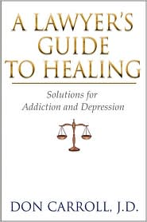
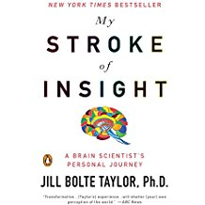
North Carolina Lawyers Assistance Program: A place to find some insight, hindsight and foresight - Links to sites on many subjects directly or indirectly related to substance abuse and understanding human behavior. See http://www.nclap.org/
Professional Assistance Practices (Law, Medicine, Dentistry, etc.) are some examples of proactive “community systems” that reflect a Recovery Model approach that incorporate prevention, treatment and environmental practices:

Slide 41
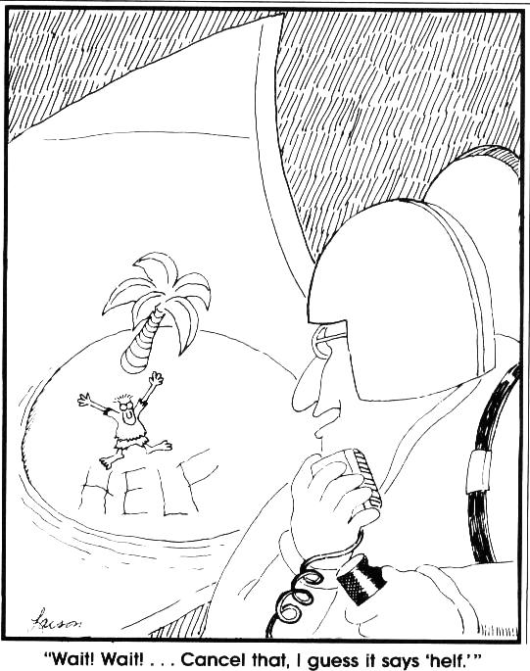

Slide 42


Slide 43
Lawyers Need Help:
Paralegals
Guardians/Power of Attorney
Investigators
Social Workers
Psychiatrists
Psychologists
Hospitals
Witnesses
Others

Slide 44


Slide 45
Working with Guardians:
Explanations
Collecting Information
Document Preparation
Locating Resources
Developing a Plan

Slide 46
Clients, Witnesses, Victims and Professionals
Substance Abuse and Dependency
Mental Illness
Trauma
Learning and Developmental Disabilities
Prevention and Recovery
Relationship-Centered Lawyering and Preventative Law
The Lawyer as First Responder
Constructive Collaboration
Position-Centered vs. Principled Centered Negotiation

Slide 47
Self-Regulating Professional Organizations already have long established Recovery Model Approaches
We might all be able to benefit from NC LAP or other Professional Health Programs, or groups such as the National Alliance of the Mentally Ill (N.A.M.I.) about improving simple every day interaction and decision-making improved skills on how to:
Understand and apply interpersonal boundaries
Provide structure but avoid having to “control”
Focus on the present, or one item at a time
Be honest, but not argumentative
Trust yourself
Understand and clarify expectations along the way
Discover (or improve) the skill of being professionally detached yet caring

Slide 48
U. S. Supreme Court Justice Anthony Kennedy wrote in the Garrett decision that Prejudice rises not from malice…*
“…it may result from some instinctive mechanism to guard against people who appear to be different in some respect from ourselves…”; and that,
“...knowledge of our own instincts teaches that persons who find it difficult to perform routine function might seem unsettling to us - unless we’re guided by the better angels of our nature.”
*From the Report from the American Bar Association for the Legal Profession, 2nd National Conference on the Employment of Lawyers with Disabilities (2009)

Slide 49
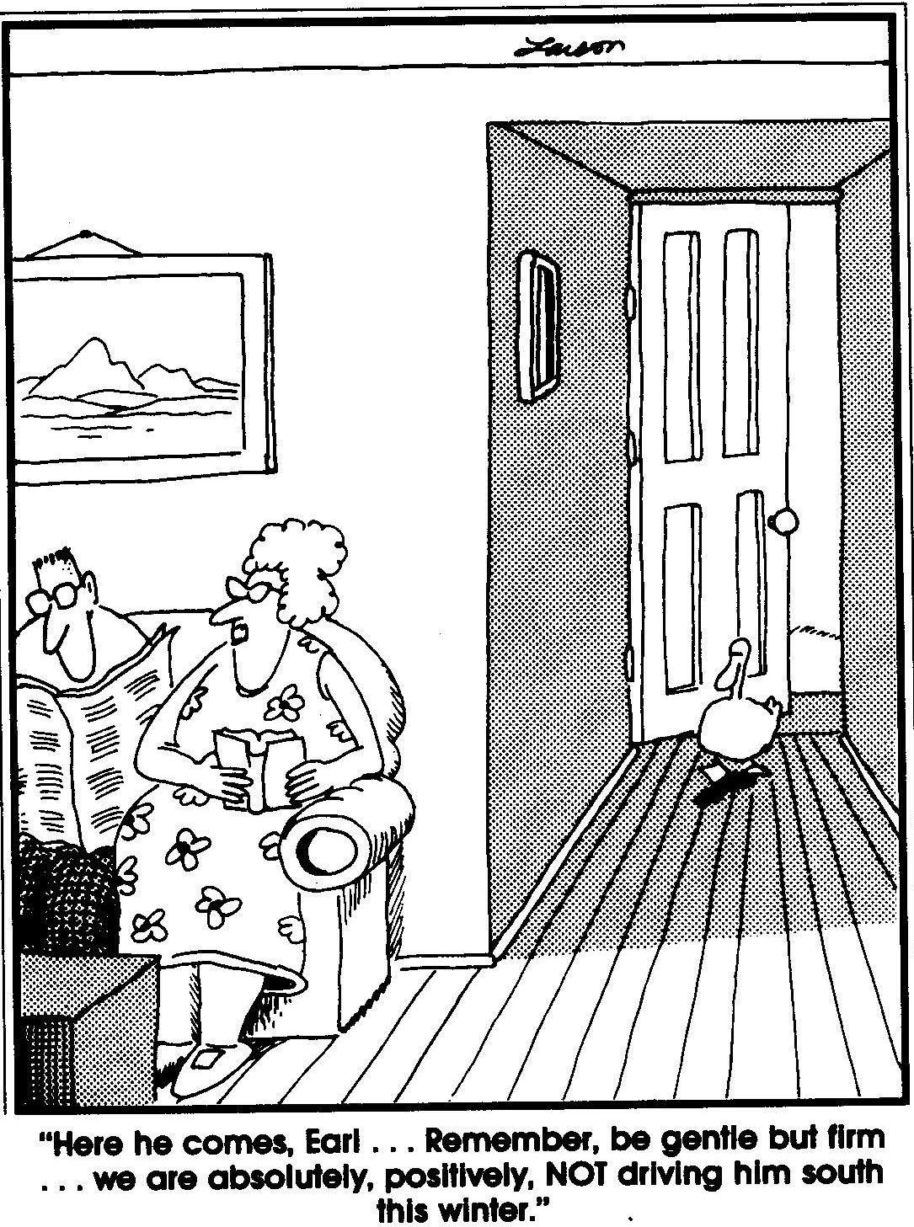

Slide 50
Law Enforcement: CIT: Crisis Intervention Teams A Peer-focused CIT Program A Trauma-informed CIT Program Mobile Crisis: Planning Crisis Response

Slide 51



We can learn from those within the educational system providing operational and cultural pathways for children with special needs – a naturally occurring Recovery Perspective
WrightsLaw
A great resource for those advocating for children with special needs. Good for those interested in therapeutic jurisprudence and otherwise.

Slide 52




Slide 53
From a lawyer’s perspective, the benefits to psychiatric advance directives and health care powers of attorney include the following:
Clients have two enforceable legal documents that empowers them to provide relevant, necessary and critical information to health care providers who otherwise use relatively limited default medical responses in crisis settings because they frequently lack sufficient and timely information about their patients.
Clients have a health care advocate that is, unlike a standard Guardian, designed to be in the role of an empowered health care agent. If Guardianship is necessary, that relationship would be more empowered as well.
Clients may avoid civil commitment or arrest through these documents with the right plan and support system, which may include having people and a process available to them in the event a crisis arises.
The instruments would still be valid in the event of a commitment or arrest, empowering the doctors, attorneys and other professionals with the information they need to make better decisions, and increasing the likelihood of early termination of such proceedings.
By executing these instruments, as well as a W.R.A.P. plan, clients might follow through with them so as to avoid the need to use them in a hospital or court setting. Better health, welfare and public safety through insight, hindsight, foresight, planning and action.

Slide 54
Hope for Rehabilitation: The Recovery Approach to Behavioral Health
“A recovery approach to mental disorder or substance dependence …emphasizes and supports a person's potential for recovery. Recovery is generally seen in this approach as a personal journey rather than a set outcome, and one that may involve developing hope, a secure base and sense of self, supportive relationships, empowerment, social inclusion, coping skills, and meaning. Other names for the concept are recovery model or recovery-oriented practice.
Originating from the 12-Step Program of Alcoholics Anonymous and the civil rights movement, the use of the concept in mental health emerged as deinstitutionalization resulted in more individuals living in the community. It gained impetus as a social movement due to a perceived failure by services or wider society to adequately support social inclusion, and by studies demonstrating that many people do recover.
A recovery approach has now been explicitly adopted as the guiding principle of the mental health or substance dependency policies of a number of countries and states. In many cases practical steps are being taken to base services on a recovery model, although a range of obstacles, concerns and criticisms have been raised both by service providers and by recipients of services. A number of standardized measures have been developed to assess aspects of recovery, although there is some variation between professionalized models and those originating in the psychiatric survivors movement.” - Wikipedia

Slide 55

“The greatest wealth is health”
Virgil
“If I had my way I‘d make health catching instead of disease...”
Robert Ingersoll

Slide 56
Contact Information
Bob Ward
704-686-0991
Robert.Ward@mecklenburgcountync.gov
Kristin Parker
704-686-0947
Kristin.Parker@mecklenburgcountync.gov

