Slide 1
Celebrating and Looking Ahead! North Carolina Guardianship Association Conference Wednesday, May 3, 2023

Slide 2
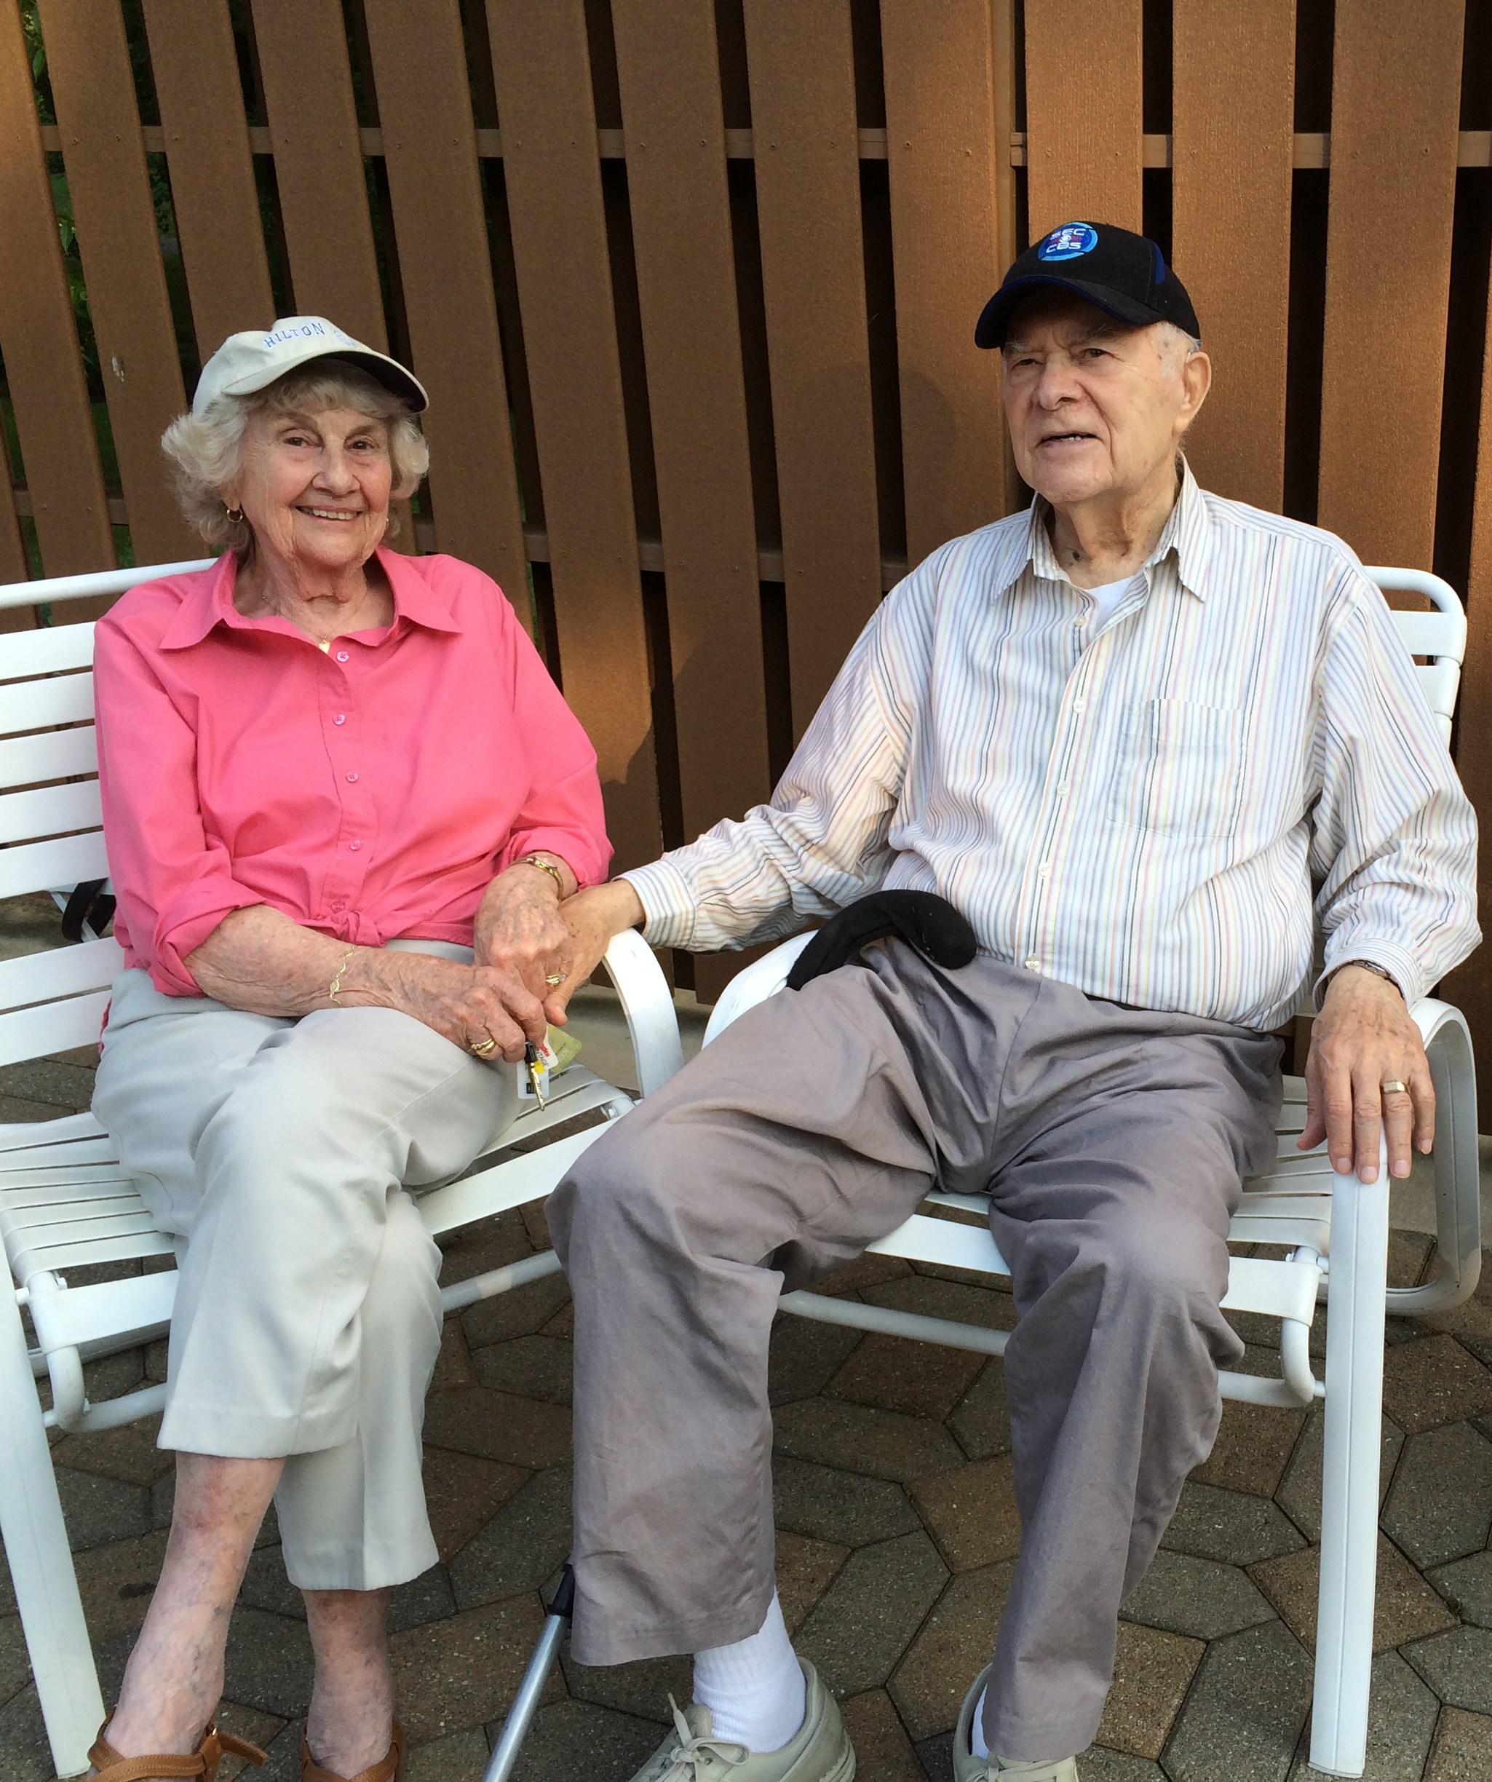
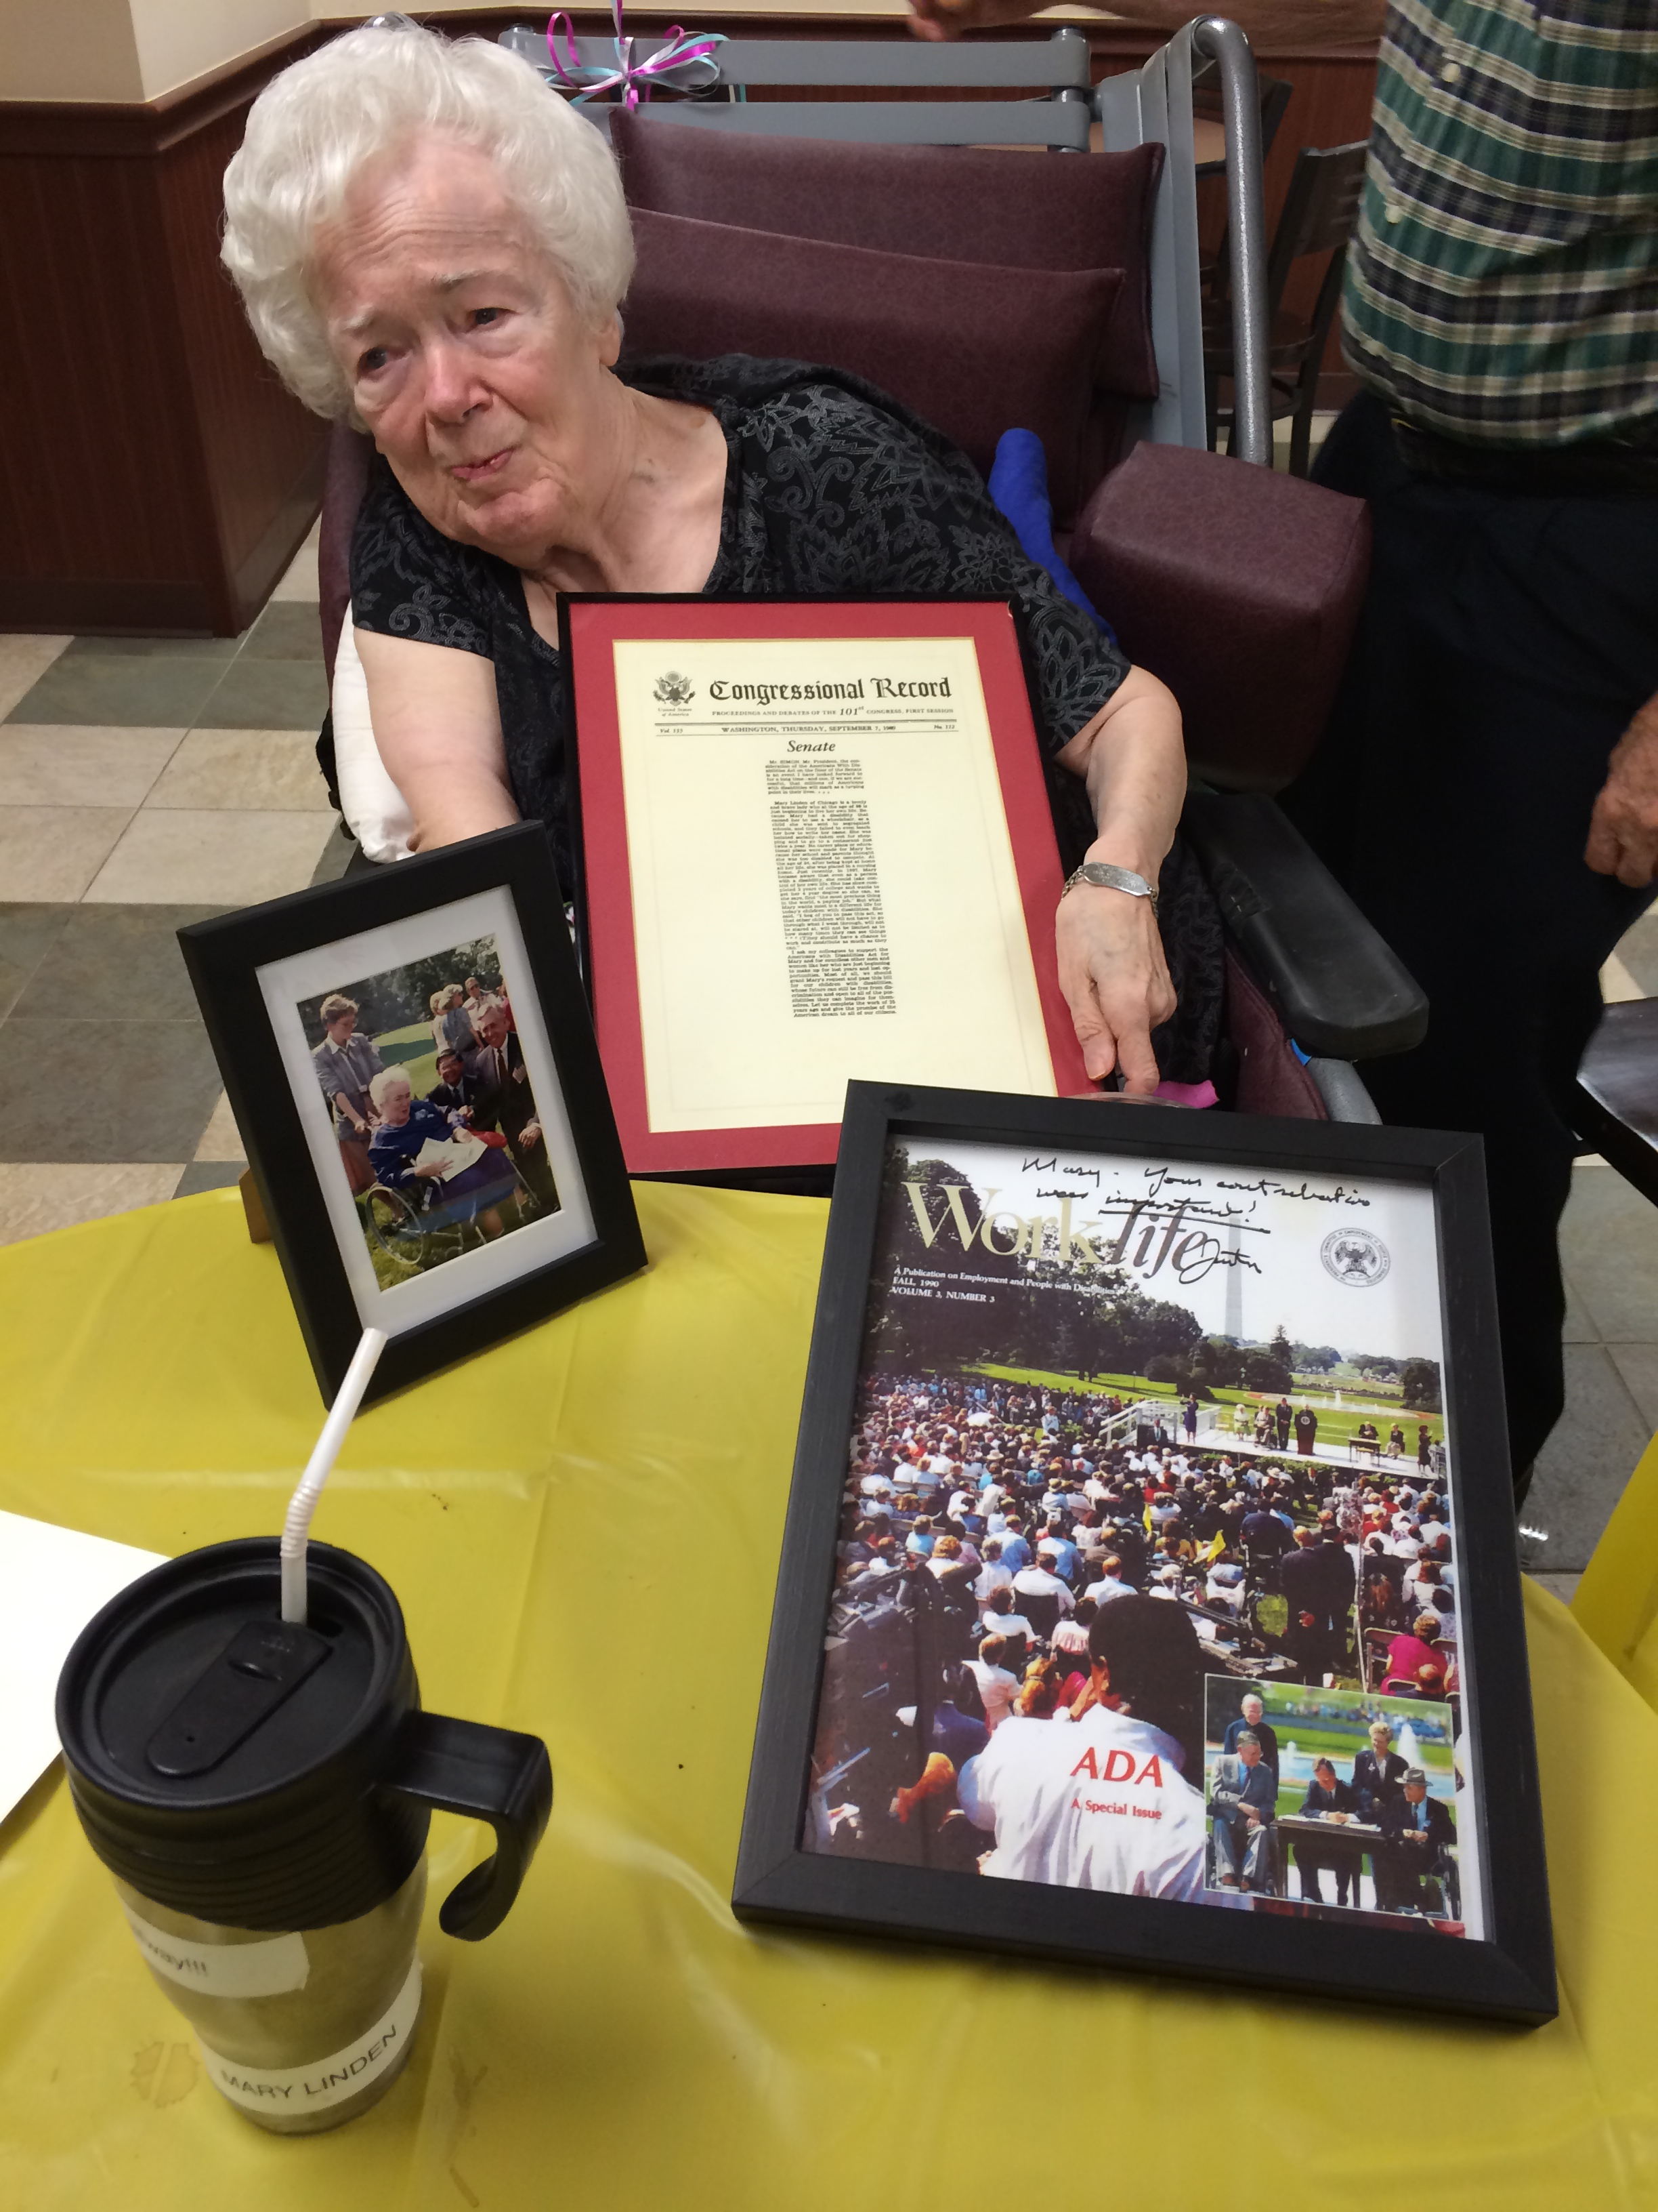
A Personal Introduction to This Work…

Slide 3
Rethinking Guardianship is …
Promoting less restrictive alternatives to guardianship
Creating long-term changes in the state’s guardianship system

Slide 4
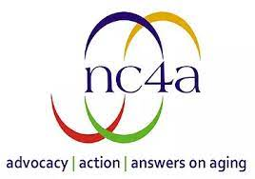
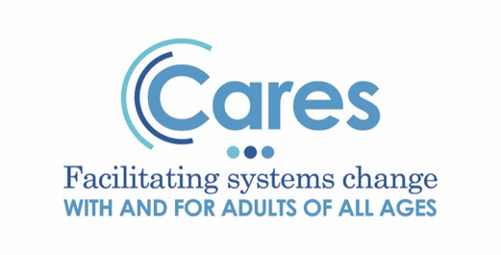
THANK YOU!!!!!
Notes:
Some of our partner organizations involved in RG

Slide 5
Our History: 8 Years of Work Leading to Today!
Rethinking Guardianship: Building a Case for Less Restrictive Alternatives –
January 2015 - December 2017
Rethinking Guardianship: A Person-Centered Approach
July 2018 – December 2019
Rethinking Guardianship Bridge Initiative
January 2020 – June 2020
Making Alternatives to Guardianship a Reality in NC
July 2020 – June 2023
Notes:
~Common agenda
~Continuous communication
~Shared measurement
~Backbone support
~Mutually reinforcing activities

Slide 6
How we worked…
Data & Stories
Outreach & Education
Legislation & Policy

Slide 7
How Many People Declared Incompetent in NC? July 1, 2012 – December 31, 2015
Notes:
Side – Legal terms are ward and incompetent. I try to avoid the term ward, please forgive me if I slip up. Use incompetent when referring to the ruling.

Slide 8
How Many People Sought & Received Restoration?
Notes:
15,798 people in dataset
468 (3.0%) had some restoration activity
326 (69.7%) of those with activity received restoration
This is only 2.1% of people with guardianship court action in those years
Only 57 (12.2%) people had a denial at the end of the record

Slide 9
Catawba Data Analysis January 1, 2015 – September 30, 2016

Slide 10
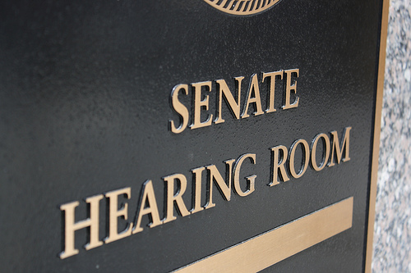
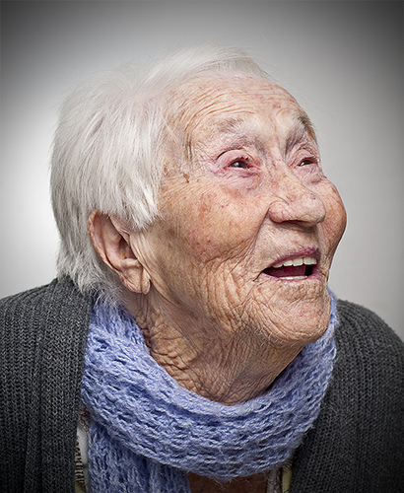
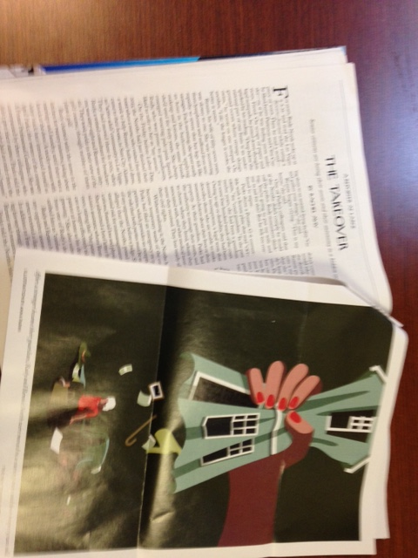
It’s About Ensuring Rights and Protecting Elders…

Slide 11
Carol Kelly: Mary Jane’s Story

Slide 12
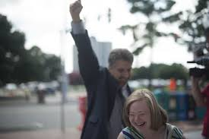
It’s Also About Adults with Disabilities of All Ages…
Jenny Hatch –”I don’t need a guardian. I just need a little help”

Slide 13
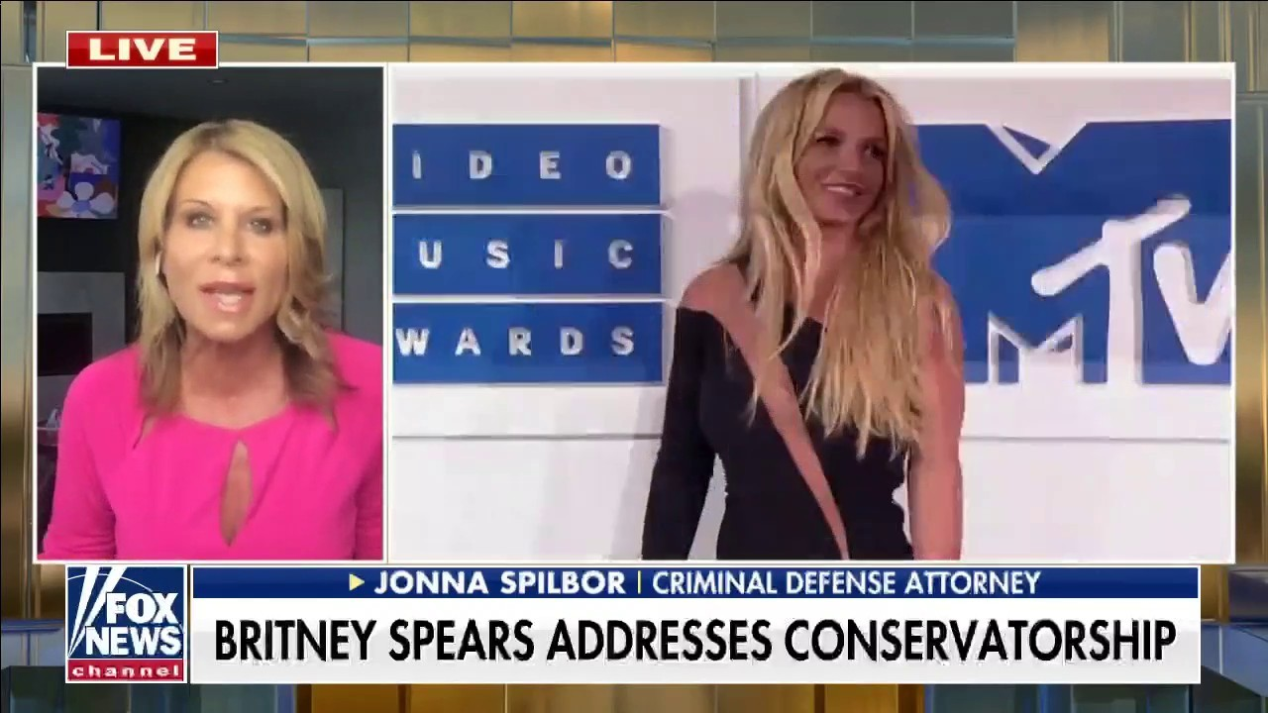
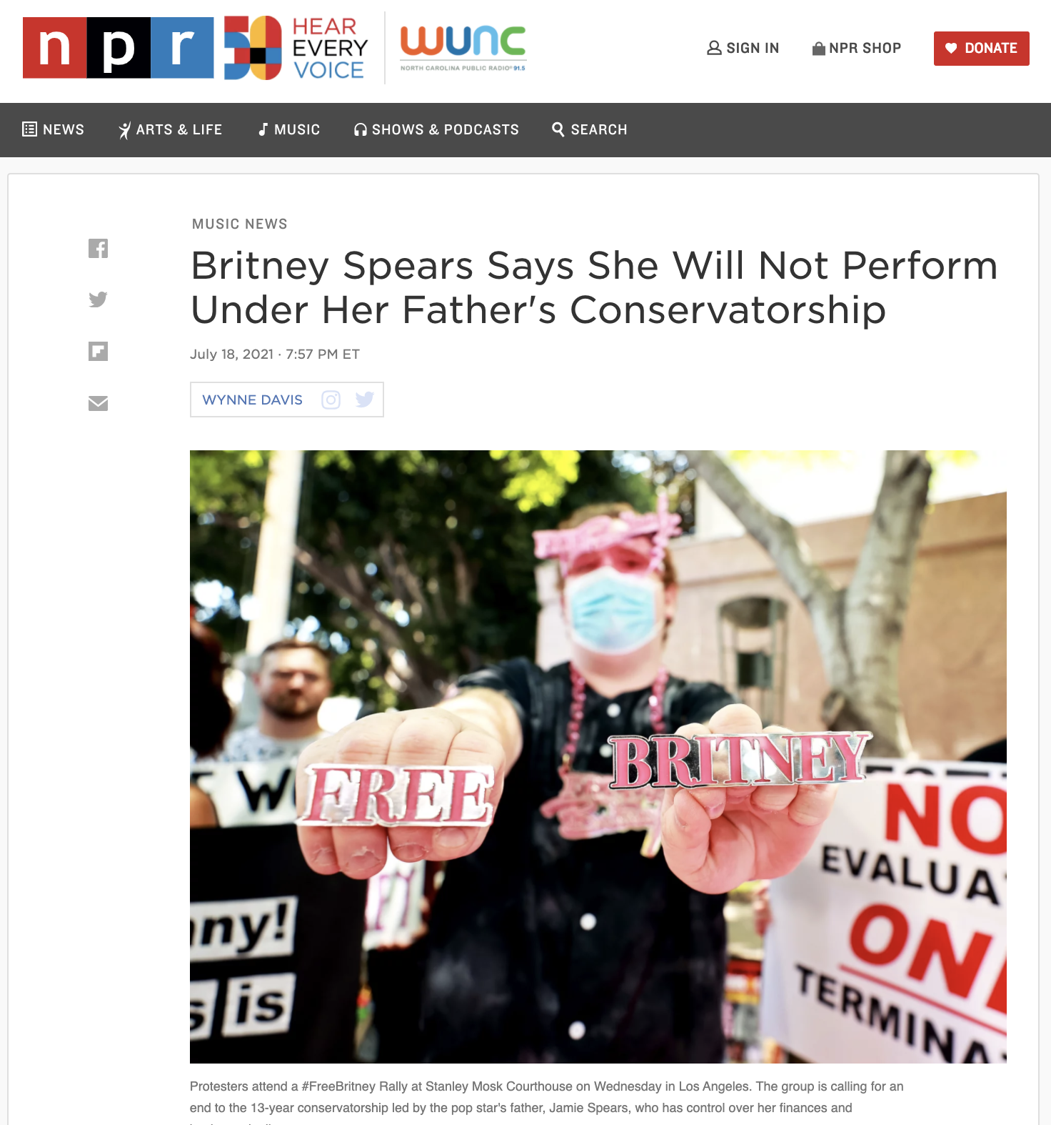
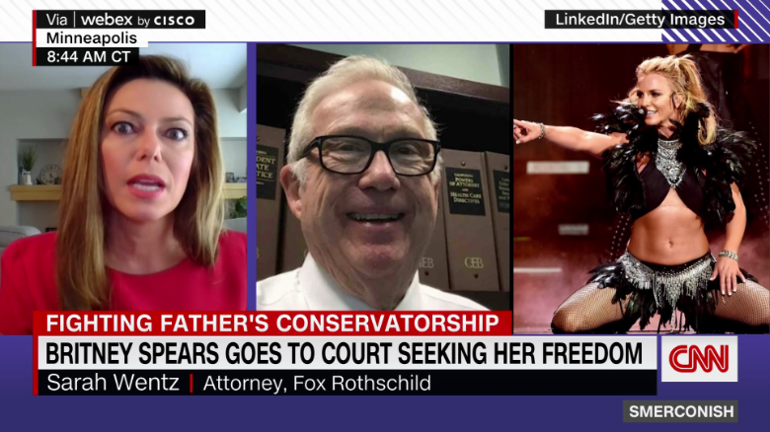
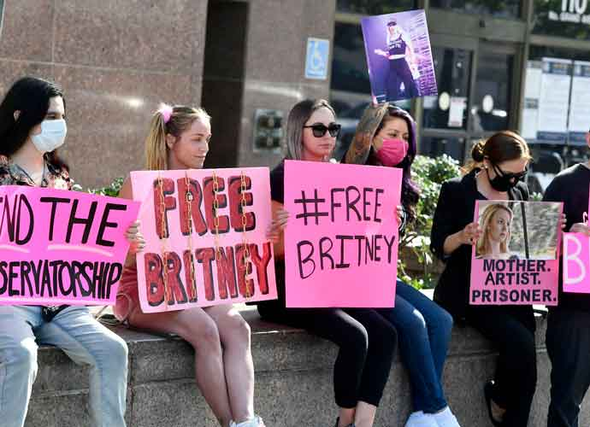
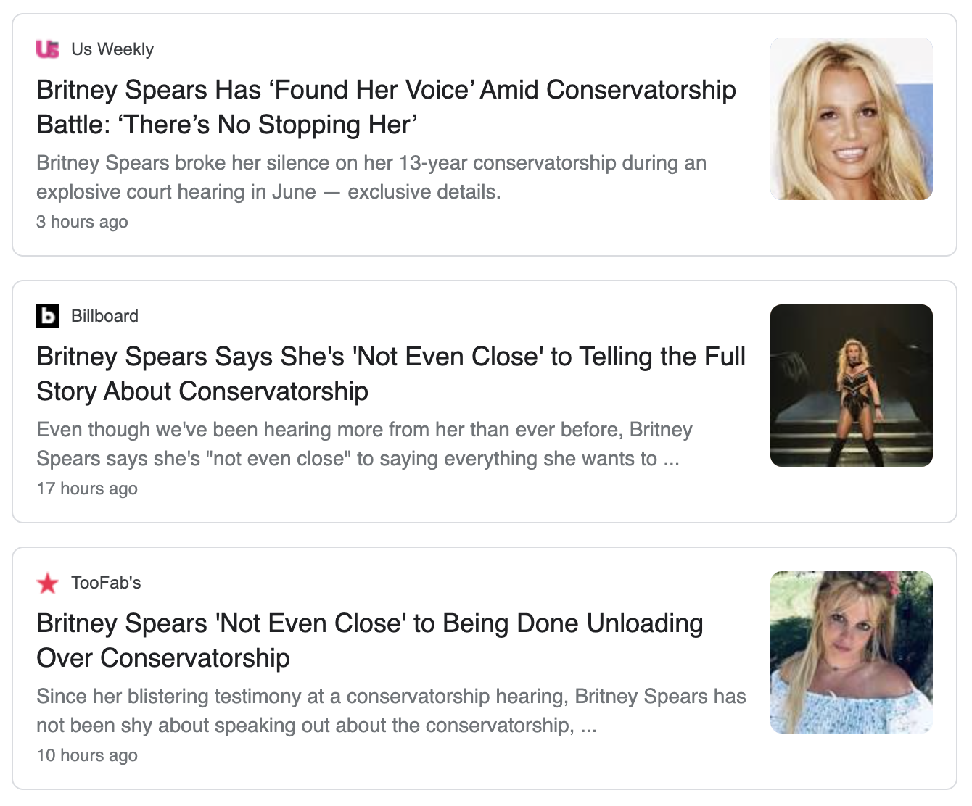
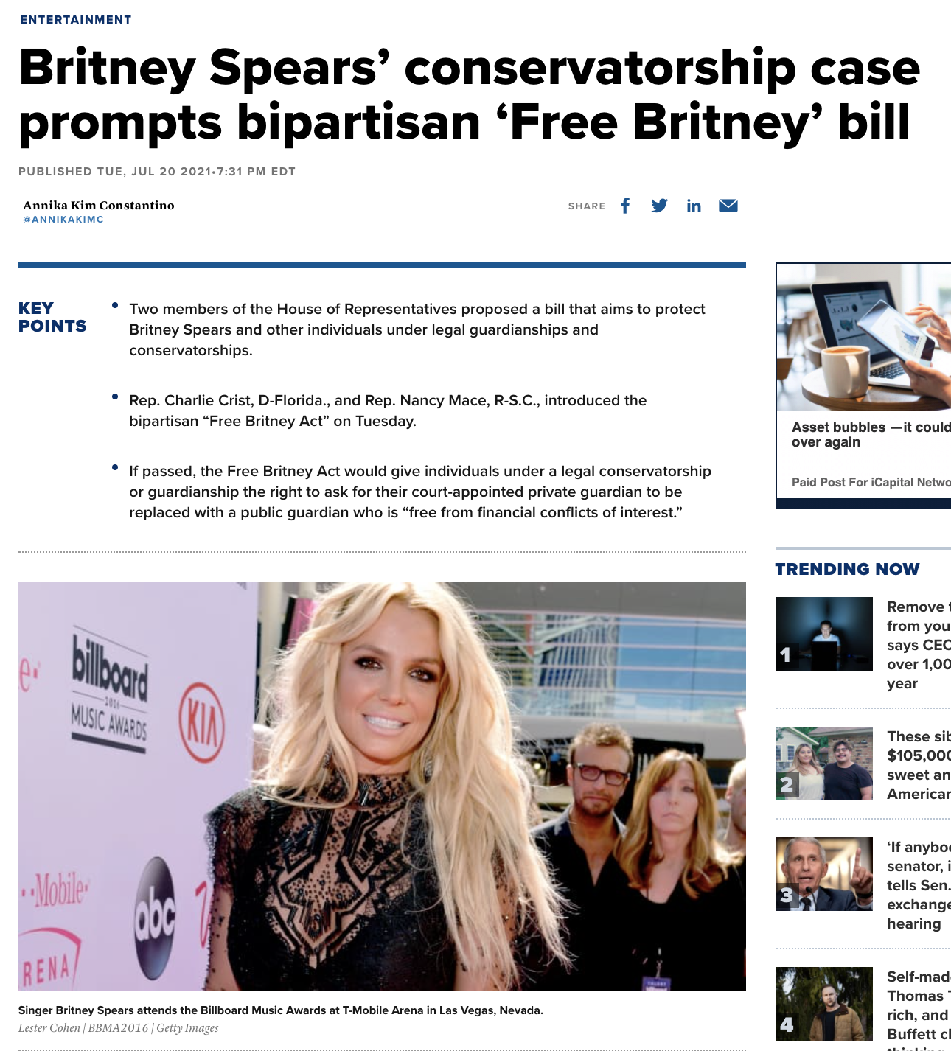

Slide 14
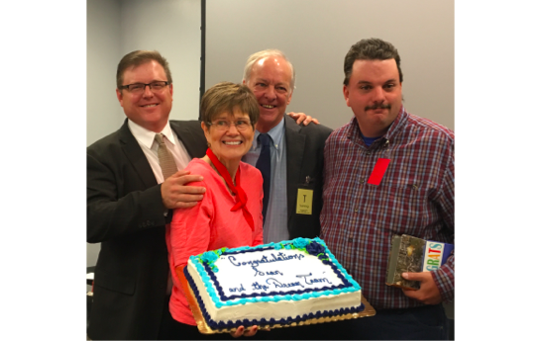
Sean’s Story

Slide 15
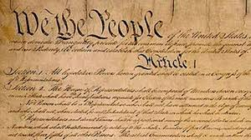
Common Agenda
Core concepts and basic principles:
Autonomy, liberty, freedom, dignity
Presumption of competence
Right to life-time decision-making support

Slide 16
Common Agenda/Shared Aspiration
The System-as-it-Should-be would:
Always use least restrictive options and be based on best practices
Offer easily available and accessible information about options and alternatives to guardianship that is communicated to and understood by stakeholders
Rest on a process in which all stakeholders are identified and engaged
Have built-in accountability for all stages of guardianship and less restrictive alternatives.

Slide 17
The Importance of a Balanced Approach
Autonomy - Support - Protection

Slide 18
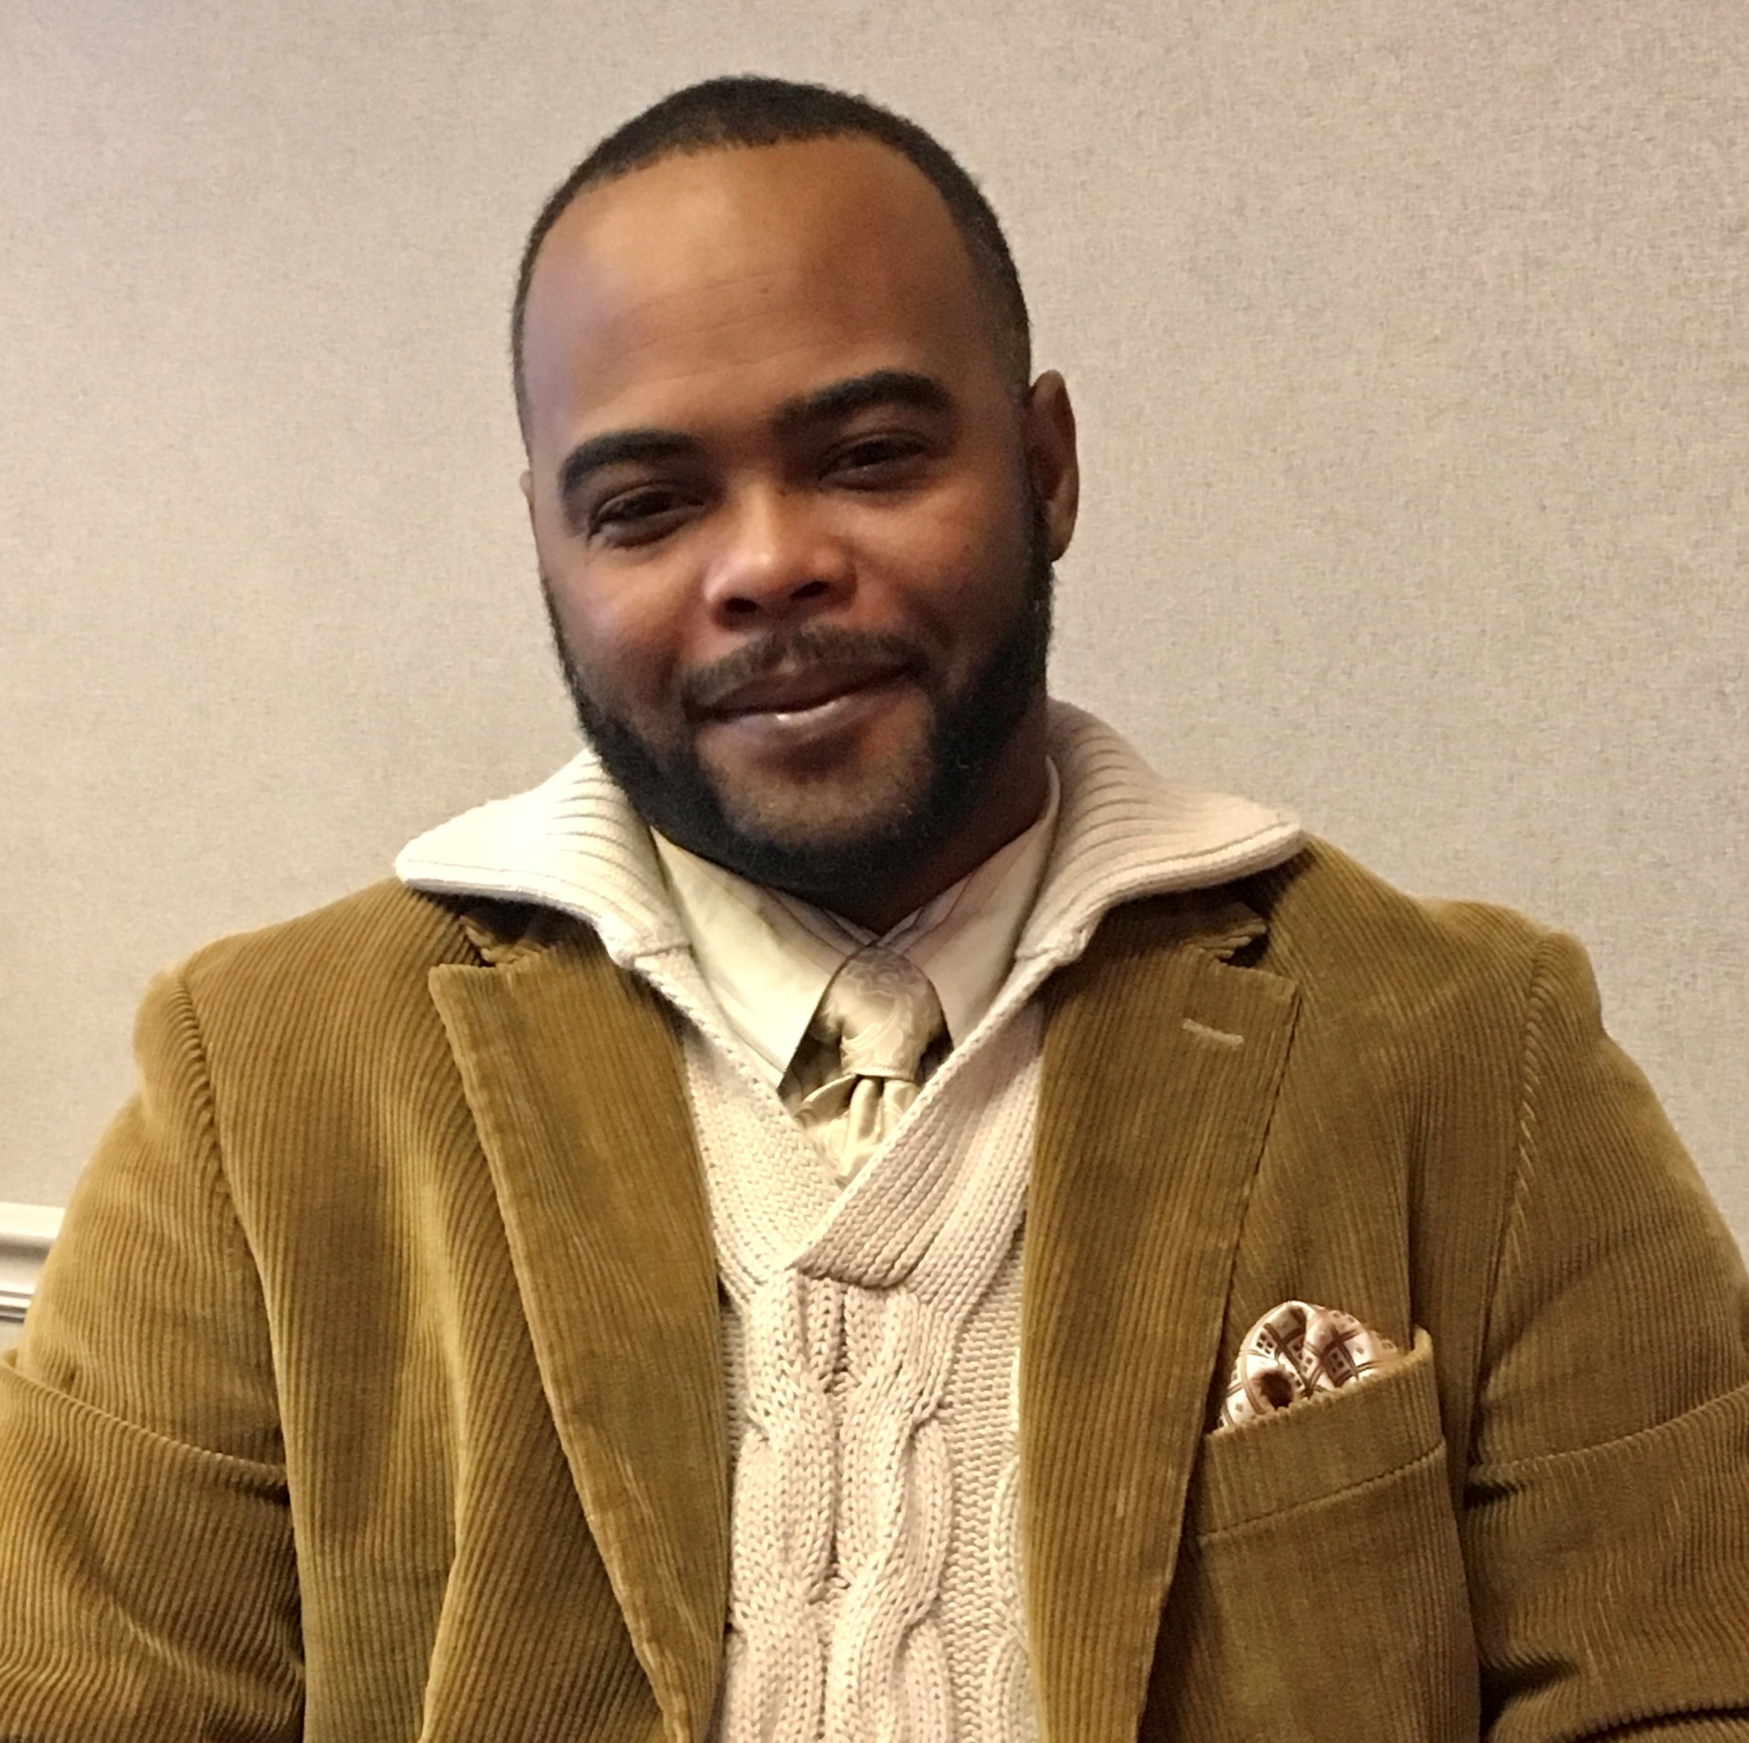
Jason’s Story
“I do it completely on my own now. Once in awhile, I ask my mother for her opinion, but I’m an adult. I make my own decisions…I value the opportunity to help others and appreciate the path that led me to… mental wellness.”

Slide 19
Making Alternatives to Guardianship a Reality in North Carolina
Recommended by Rethinking Guardianship - NCCDD Funded for July 2020 – June 2023
Focused on Youth Transitioning to Adulthood and Adults Transitioning to the Community from Long Term Residential Facilities
“If you want fewer guardianships, stay out of the courtroom”

Slide 20
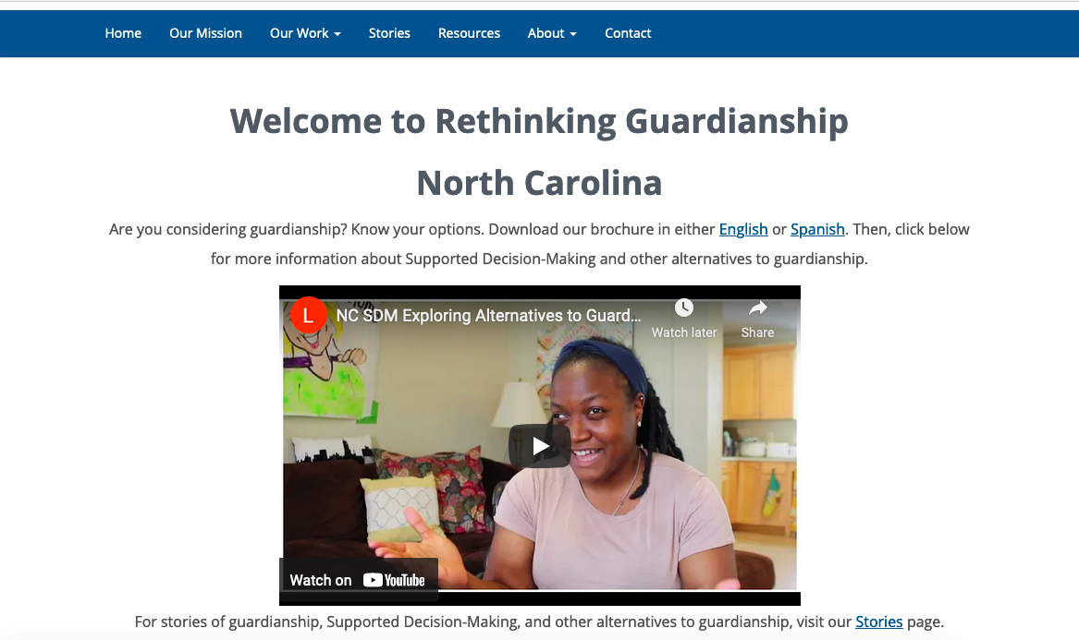

Slide 22
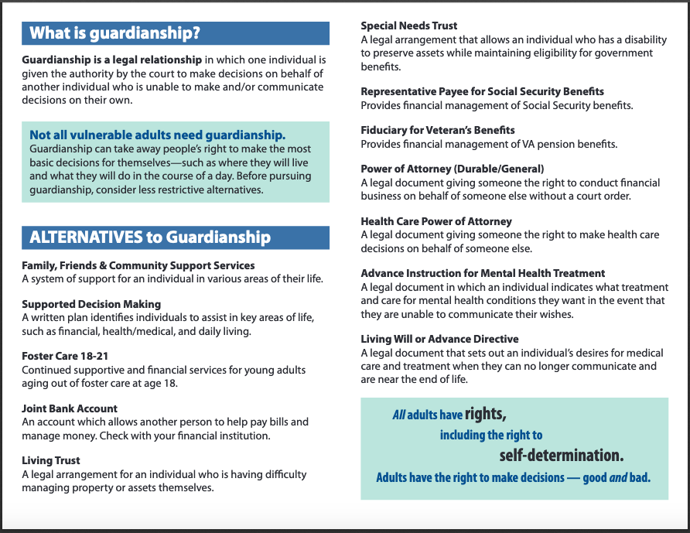

Slide 23
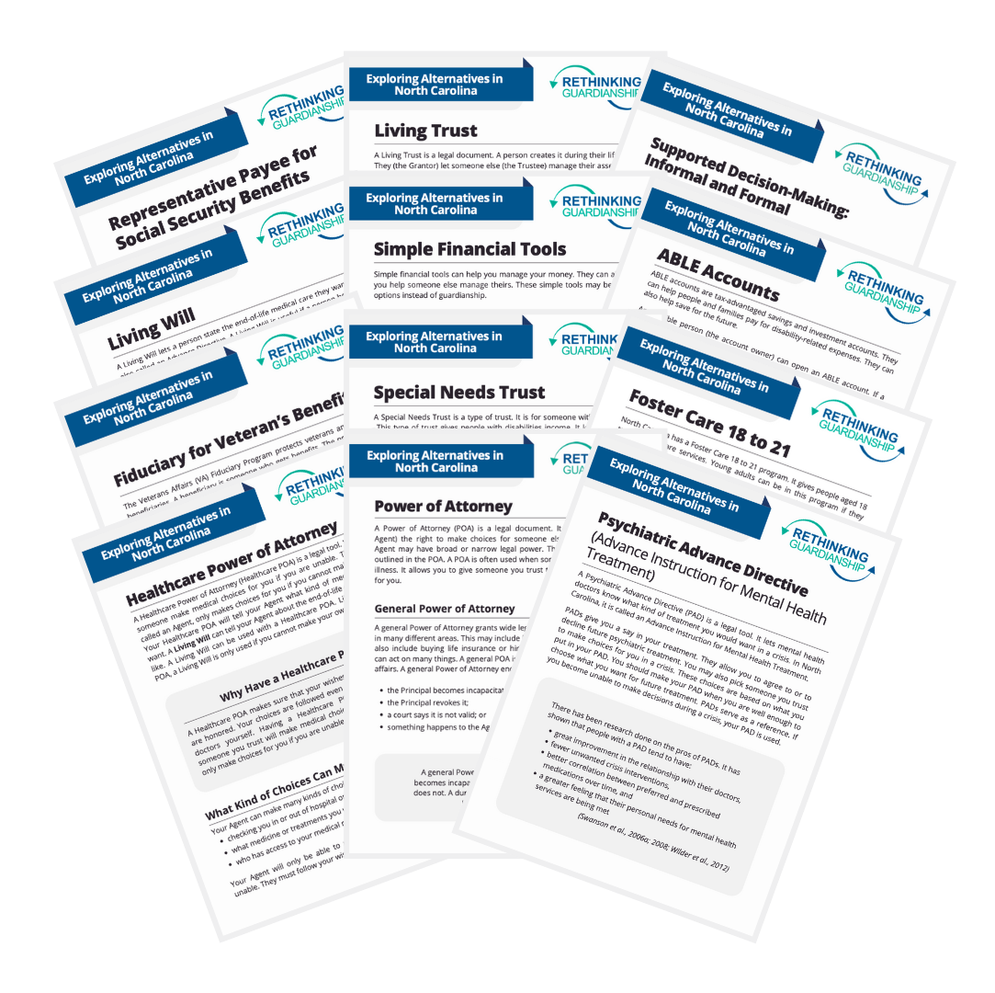
Twelve User-Friendly Instructional Sheets on Using Less Restrictive Options

Slide 25
Resources Available at RG Website
Self-advocacy tools
Stories and videos
Frequently Asked Questions
Educational materials on SDM and other options
Research and data
Court procedures information
Articles
Notes:
Resources include:
Self advocacy tools
Stories and videos
Frequently Asked Questions
Educational Materials on SDM and other options
Research and data
Court procedures information
Articles

Slide 26
NC GS 35A Reform Worked with NC Bar Association to Introduce Bill in 2023!
Notice of Rights for those under guardianship
Mandatory requirement for Consideration of Alternatives to guardianship
Process for Regular Reporting by Guardians of the Person with additional safeguards in the court system re: excess attorney fees
Change language ex: eliminate “ward” & “incompetent” (2024)
Provide for Appointed Counsel in addition to GAL (2025)

Slide 27
2023 Legislative Proposal: Goals
Every person for whom guardianship is sought has a clear understanding of his or her rights, both before and after guardianship;
Guardianship is used only as a last resort if no less restrictive alternative is available; and
Give courts effective tools for review and oversight to make sure guardians are fulfilling their responsibilities.

Slide 28
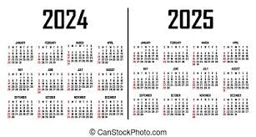
What’s next for Statutory Reform?
Change language and terminology
Right to Counsel/rethink GAL system

Slide 29
What’s Next for Rethinking Guardianship?
More statutory reform (as noted in previous slide)
Maintenance of Learning Community and Website
Work with staff and guardians of those living in State Developmental Centers through Medicaid/Money Follows the Person funding
Address the educational needs of:
Clerks & legal system
Hospitals & health care system
Social Service system (some funding through Division of Aging & Adult Services)
General public – petitioners

Slide 30
What do you think?
1. What is left to do to improve the system & promote alternatives?
2. How can ongoing work be continued & funded?

Slide 31
More Information & Conversations Ahead!
Visit the Rethinking Guardianship website
https://rethinkingguardianshipnc.org/
Join the Rethinking Guardianship Workgroup! Email me at lkfields@email.unc.edu

Slide 32
Linda Kendall Fields M.Ed.
Clinical Associate Professor
UNC Chapel Hill School of Social Work
(828) 712-4003
lkfields@email.unc.edu

