Slide 1
“Let Me Gamble, Drink, and Smoke in Peace” A Case Study and Discussion of Self-Determination, Alcohol and Substance Abuse, and “Soft Tools” to Prevent and Address Elder Abuse.
The stories you are about to hear are based on real cases. For confidentiality, the names and events have been changed.
This picture is of Paula’s father, a retired surgeon who placed himself in harms way, but with the assistance of his children was provided with a safe and secure environment to live out his final years.
We hope this presentation will inspire others to take preventive steps and identify non-judicial interventions when appropriate.

Slide 2
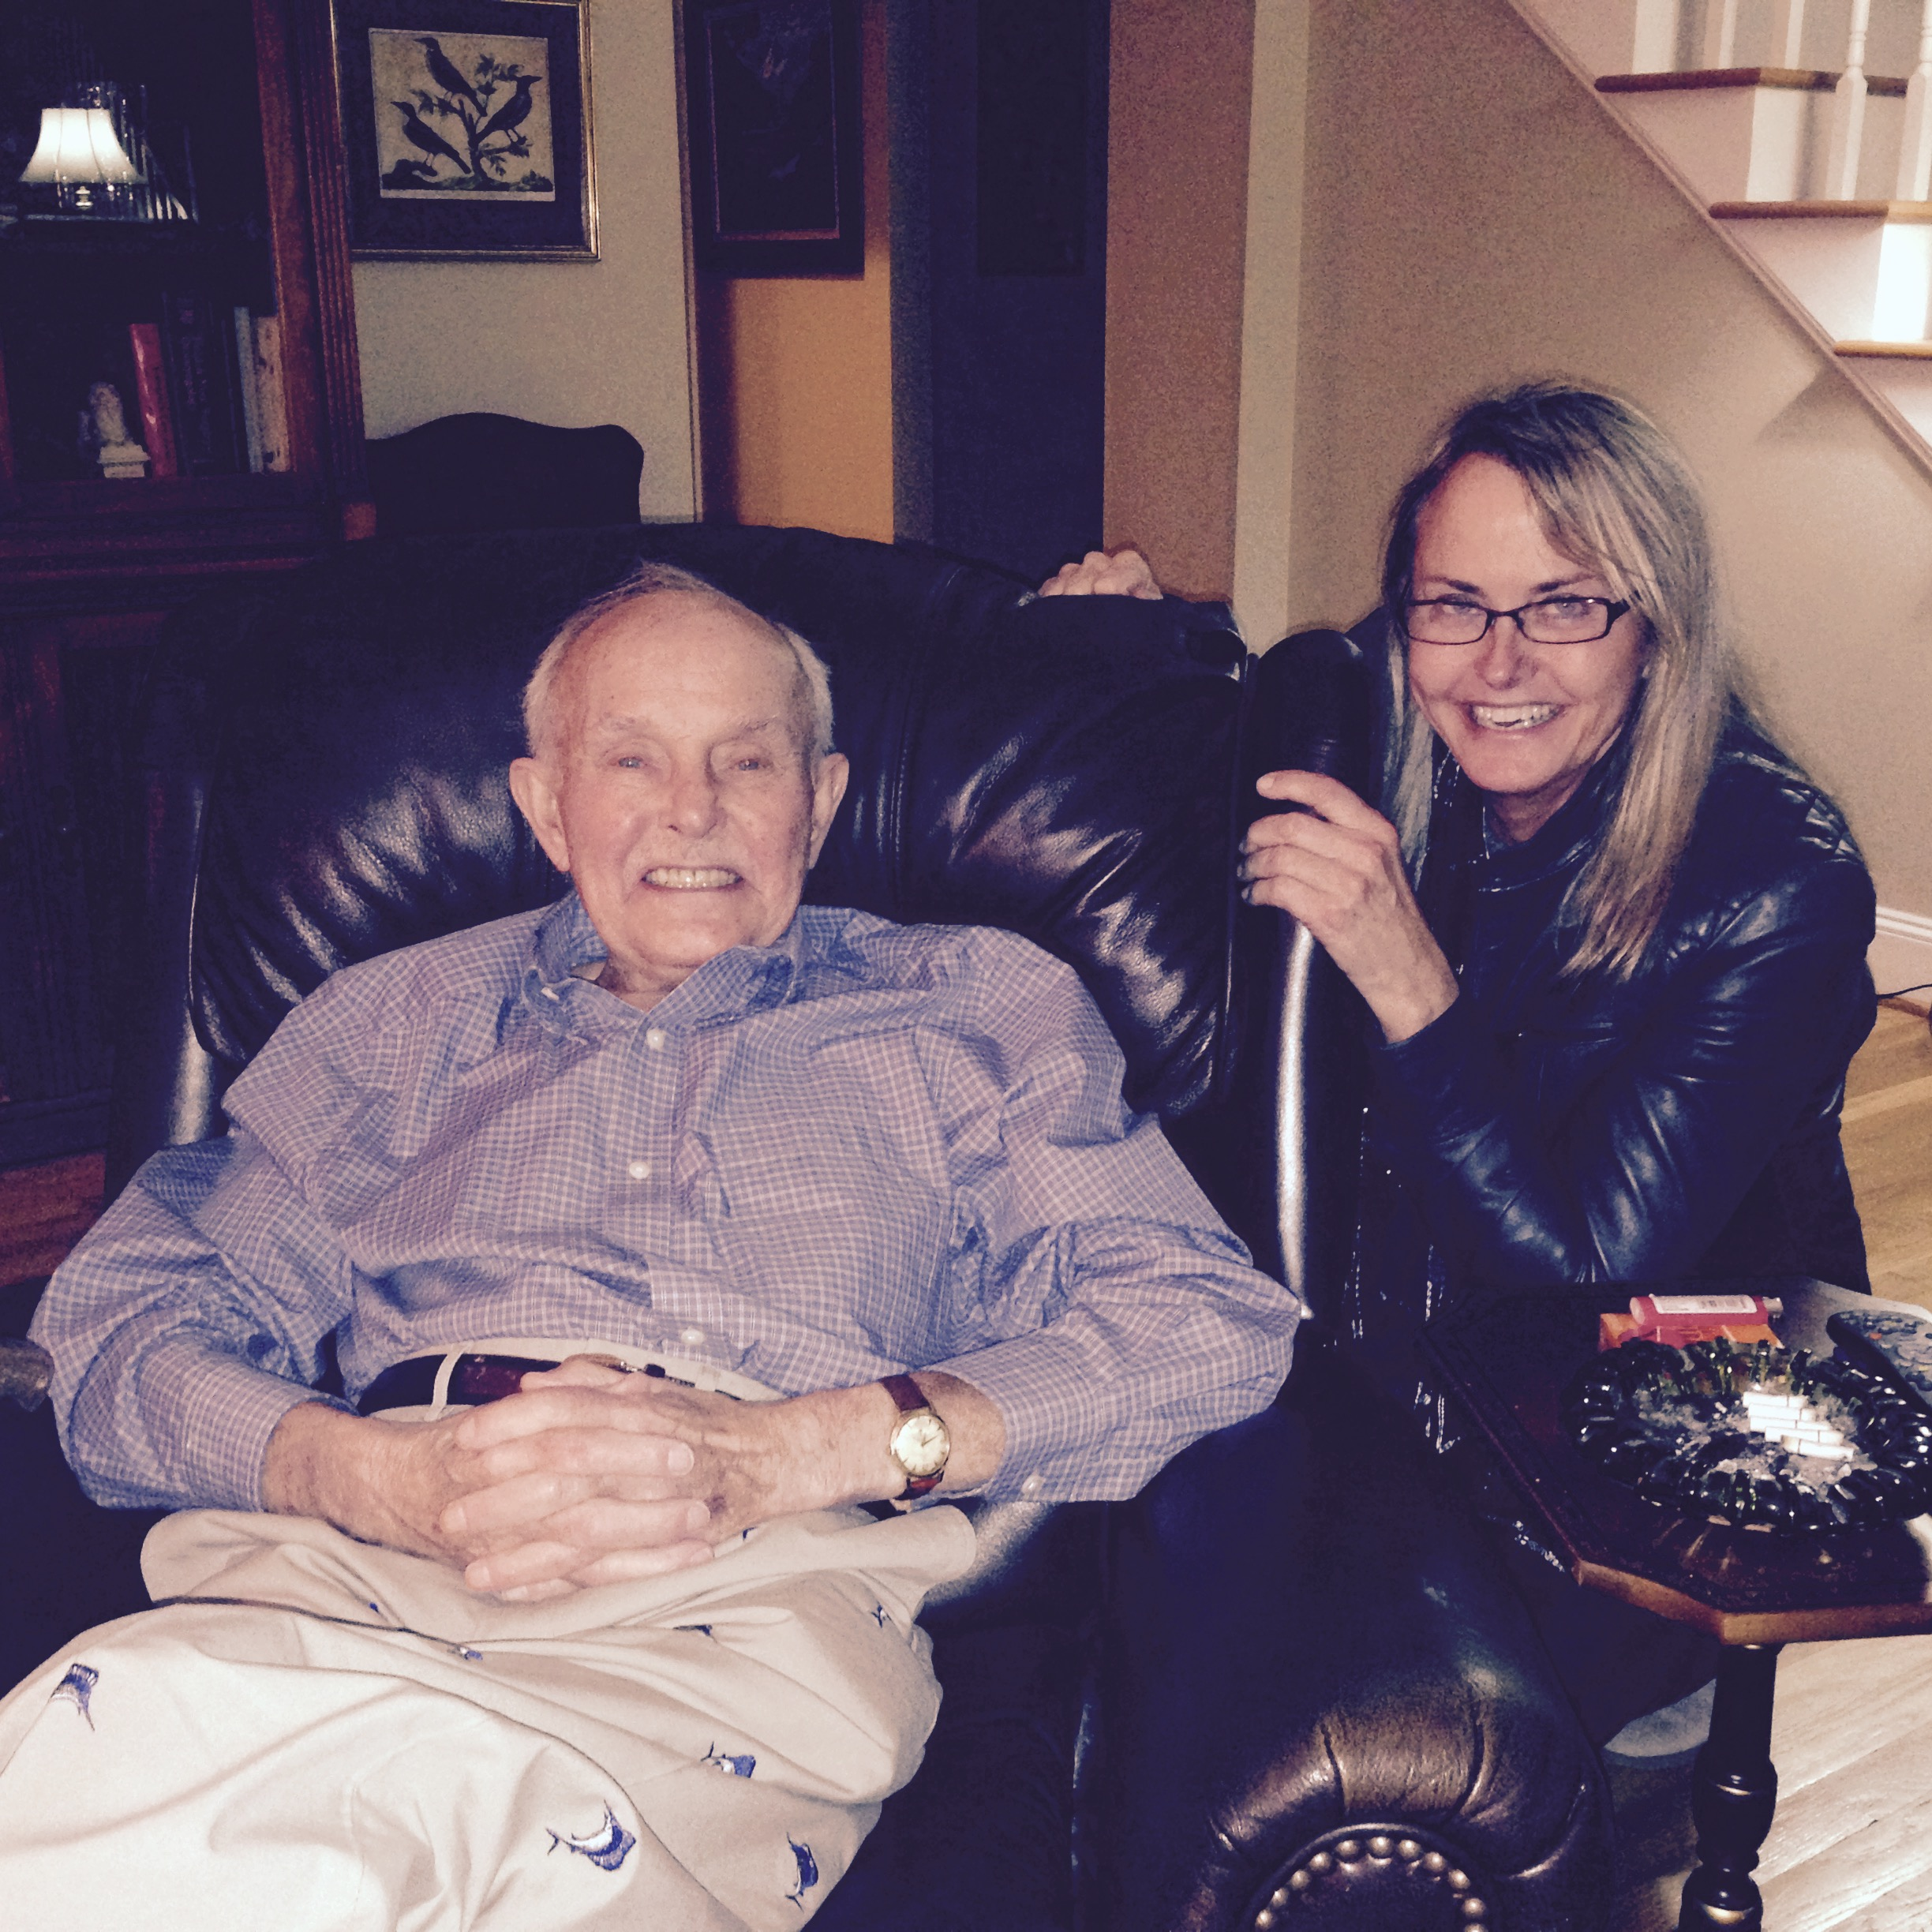
Dr. Bob
Heavy drinker and smoker
Widower
Began making unusual investments and financial decisions
Began entrusting new people with no experience
Children intervened with “soft tools” to move him from isolated location to a residence with round-the-clock caregivers

Slide 3
Fred
Heavy drinker and smoker
Widower
Entrusted property to a child
Exploiter: Child(ren)
Companion assisted him in getting legal assistance
Legal Aid
Referral to law firm
Defended Against Guardianship

Slide 4
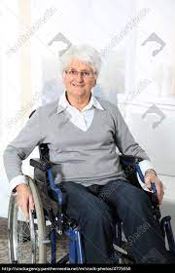
Samantha (Sam)
Stroke victim
Husband became POA and gambled away inheritance.
On husband’s death, cousin was only available family to serve as POA.
Exploiters: Husband and Cousin
POA gave attorney the power to request accountings from cousin.

Slide 5
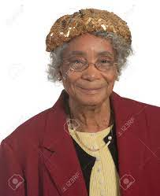
Alice
Early onset dementia
Left longtime friend network to move near only child
Exploiter: Child
Banker discovered exploitation and alerted other family member who engaged attorney

Slide 6
What Put My Dad (and your Mom or Dad) at Risk
Financial Independence – handled his own financial affairs
Widower/Divorced – his first wife died, then divorced
Risky Drinker – heavy drinker
No external check and balances
Loneliness
Isolation

Slide 7
Self Determination: Risky Behaviors and Habits
Financial Independence: Without a plan for obtaining assistance with finances in the future, elders who successfully and independently handled their finances are at risk.
Prevention – Lawyers, doctors, accountants, financial advisors and bankers. Trustworthy family members and friends.
Risky Habits: Alcohol and substance abuse, gambling and other addictive behaviors substantially increase the risk for exploitation and abuse.
Understanding that alcohol and substance abuse are a disease.
Process addictions – e.g., gambling, pornography, etc.
It is never too late for help or to intervene.
First things first.
Developing a network of trusted advisors/persons.

Slide 8
Many Perpetrators of Exploitation or Abuse Start Off With Good Intentions
US Baby Boomers
Every day 10,000 people turn age 65.
By year 2030, all boomers will be at least age 65.
In 2023, Baby Boomers make up one-fifth of the U.S. population
Also, national population is growing because we are living longer - in part due to better health care.

Slide 9
Stigma for Older Adults
Many believe mental health & substance use is not preventable or worth treating in older adults.
Many believe that mental health conditions are a natural part of the aging process.
By: Shevel Mavins ADDICTION-PREVENTION.ORG

Slide 10
Substance Use & Prescription Misuse Facts
Older Americans with Substance Use Disorder is expected to rise from 2.8 million in 2002–2006 to 5.7 million by 2020
According to National Survey on Drug Use and Health illicit drug use is more prevalent among American older adults than among older adults in almost any other country in the world
Projections shows by the end of 2020, illicit drug use for adults 50 or older will increase from 2.2% to 3.1% (1.6 million to 2.19 million).
Alcohol & prescription drugs, for ages 60 and up is the fastest growing health problems facing us.
National survey shows, 40% of adults 65 and older drinks alcohol
13% of the population is 65 years of age and older, but account for 30% of all medications prescribed in the US.
By: Shevel Mavins ADDICTION-PREVENTION.ORG

Slide 11
INVISIBLE PROBLEM
Older adult’s alcohol problems increase, but the problem is unrecognized and untreated. Why?
Substance Use Disorder effects can affect capacity & loss of control (decision making ability)
By: Shevel Mavins ADDICTION-PREVENTION.ORG

Slide 12
Many Perpetrators of Exploitation or Abuse Start Off With Good Intentions
The relationship starts with good intent:
Provide support during illness or post op care.
Move in to assist with mobility, memory or other limitations.
Failure to seek respite care.
Common Rationalizations:
I have helped when no one else would.
It would cost a fortune to hire someone to do what I have done.
Those kids are ungrateful.
Typical Relationships:
Adult Child
Companion
Neighbor

Slide 13
PROTECTIVE ESTATE PLANNING
Establishing a Relationship with Trusted Advisors:
Lawyers
Accountants
Bankers/Financial Advisors
Provide Access to Financial Account Information:
Not authority
Copies or access online
HIPAA Authorization
Power of Attorney Appointing Trusted Family Member (or Trust Company)
Recognizing limitations of proposed agent.
Consulting with an estate planning or elder lawyer – not all POAs are alike.
If possible, introduce agents under POAs to Trusted Advisors

Slide 14
Key Estate Planning Documents
General/Durable Power of Attorney
Health Care Power of Attorney
HIPAA Authorization
Names an agent to make health care decisions for an individual
Allows health care provides to share protected health information with named individuals
Who is named as agent? Co-agents?
Are Gifts Allowed? Agent can only make gifts if power is expressly granted in POA
Names an agent to make financial decisions for an individual
When does it kick in?
When does it terminate?
When does it kick in?
When a health care provider determines the individual is unable to make his or her own health care decisions

Slide 15
Key Estate Planning Documents
Last Will and Testament
Revocable Trust / Living Trust
Irrevocable Trust
Often used in conjunction with a Will
Separate trust created to own assets
Directs the disposition of an individual’s estate upon death and appoints individuals to serve as executor(s)
Appoints a trustee to manage assets (frequently the settlor)
Can generally be revoked or amended during grantor’s life
Cannot be amended without consent of all parties
Note: POD, Survivorship rights and beneficiary designations override provisions in a will and revocable trust
Can own assets during life or receive assets at death

Slide 16
Some Early Signs of Financial Exploitation
Excessive expressions of appreciation by victim of caregiver/friend/advisors for their assistance.
Victim deferring to caregiver/friend/advisor, who has no qualifications, instead of trusted and established advisors.
Unusual and unpredictable transfers between financial accounts and creation of new accounts: This is a hallmark of early exploitation. It can be due to the inexperience of the perpetrator with financial affairs or an attempt to see how far they can go without raising concerns.
Isolation of the victim.
Creating or amplifying family discord.

Slide 17
First Steps to Interrupt Exploitation
Game of Chess
Do not react
There is dysfunction in all families.
The victim’s own judgment is at stake if trust has been placed in the wrong person.
The perpetrator will often engage in behavior to incite a response and then confirm to the victim that the family/intervenor is the problem.
Remember: alcoholism and substance abuse are a disease; bad behavior is a symptom.
Coordination among family and friends whenever possible
The perpetrator will try to divide and conquer.
Remember: the family may not be receptive to change
Not all problems and dysfunction can be corrected.

Slide 18
Don’t Get Angry, Be Clear and Never Apologize For Intervening
The Initial Confrontation
Don’t get angry, be polite.
Be clear and repeat as necessary.
The exploiter will do their best to stage a good interview/meeting and look for validation from a person in authority.
If exploitation is suspected and the perpetrator is “offended”, make clear that you regret the person feels badly about your inquiry, but you are only being asked to do what the victim entrusted you to do, or the law requires you to do.
Whether family, social worker or investigator, it is fine to say this is outside my jurisdiction. However, if there is something amiss, a statement that there seem to be issues that should be addressed in a civil proceeding or other manner to avoid validating suspect behavior.

Slide 19
Alternatives to Guardianship
Coordination among family and friends whenever possible
Involvement with finances if prudent and safe
Regular visits
Durable (Financial) Power of Attorney so agent can help manage assets
Health Care Power of Attorney so agent can help with health care decisions
Revocable Trust so trustee can help manage assets
Special Needs Trust / ABLE Account
Representative Payee for Social Security Benefits

Slide 20
Final Thoughts
Engage counsel early if possible
Can help create non-judicial courses of action to minimize and stop exploitation
Other options
DSS / APS
Law Enforcement
Legal Aid Senior Law Project
Campbell University Senior Law Clinic

Slide 21
Thank you!
Paula A. Kohut, JD
Kohut, Adams & Randall, P.A.
513 Market Street
Wilmington, NC 28401
910-815-4066
pkohut@kohut.pro
Anne J. Randall, JD
Kohut, Adams & Randall, P.A.
513 Market Street
Wilmington, NC 28401
910-815-4066
arandall@kohut.pro

