Slide 1
Introduction to
Supported Decision-Making
Jonathan Martinis
Senior Director for Law and Policy
The Burton Blatt Institute at Syracuse University
Project Director,
National Resource Center for Supported Decision-Making

Slide 2
First Principles
What’s Your Favorite Right?

Slide 3
Rights=Choice
"I am my choices. I cannot not choose. If I do not choose, that is still a choice. If faced with inevitable circumstances, we still choose how we are in those circumstances.”
- Jean Paul Sartre

Slide 4
Rights=Choice
Choice=Self-Determination
Life control
People’s ability and opportunity to be “causal agents . . . actors in their lives instead of being acted upon”
- Wehmeyer, Palmer, Agran, Mithaug, & Martin, 2000.

Slide 5
Benefits of Self-Determination
People with greater self determination are:
Healthier
More independent
More well-adjusted
Better able to recognize and resist abuse
- Khemka, Hickson, & Reynolds, 2005; O’Connor & Vallerand, 1994; Wehmeyer & Schwartz, 1998

Slide 6
A Critical Question
Are Your Rights Worth ANYTHING If You’re Not Allowed to Use Them?

Slide 7
And Yet: 1,500 Years and Counting
Ancient Rome: “Curators” appointed for older adults and people with disabilities.
5th Century Visigothic Code: “people insane from infancy or in need from any age . . . cannot testify or enter into a contract“
Feudal Britain: divided people with decision-making challenges into “idiots” and “lunatics” and appointed “committees” to make their decisions

Slide 8
Guardianship is not the problem
Overbroad or Undue Guardianship Is!
Still, the most common conservatorship, nationwide, is “Plenary” or “Full”
Gives the Guardian power to make ALL decisions for the person.
Used in up to 90% of cases
“As long as the law permits plenary guardianship, courts will prefer to use it.” -Frolik, 1998

Slide 9
This isn’t always a Problem
Guardians have “substantial and often complete authority over the lives of
vulnerable [people].”
- 4 NAELA J. 1, 7 (2008).
This includes power to make the most basic health, personal, and financial decisions.
- AARP, Guardianship Monitoring: A National Survey of Court Practices 1-2 (2006).

Slide 10
But This Is
“The typical ward has fewer rights than the typical convicted felon . . . . By appointing a guardian, the court entrusts to someone else the power to choose where they will live, what medical treatment they will get and, in rare cases, when they will die. It is, in one short sentence, the most punitive civil penalty that can be levied against an American citizen.”
- House Select Committee on Aging, H.R. Rpt. 100-641 (opening statement of Chairman Claude Pepper)

Slide 11
As We’ve Known For Forty Years
When denied self-determination, people:
“[F]eel helpless, hopeless, and self-critical” - Deci, 1975.
Experience “low self-esteem, passivity, and feelings of inadequacy and incompetency,” decreasing their ability to function - Winick, 1995.

Slide 12
But We Meant Well
“Experience should teach us to be most on our guard to protect liberty when the Government’s purposes are beneficent. . . . The greatest dangers to liberty lurk in insidious encroachment by men of zeal, well-meaning but without understanding.”
Olmstead v. U.S., 277 U.S. 438 (1928)

Slide 13
The Limits of “Meaning Well”
People under overbroad and undue guardianship can experience a “significant negative impact on their physical and mental health, longevity, ability to function, and reports of subjective well-being”
- Wright, 2010

Slide 14
On The Other Hand
Older adults with more self-determination have improved psychological health including better adjustment to increased care needs.
- O’Connor & Vallerand, 1994
People with disabilities who exercise greater self-determination have a better quality of life, more independence, and more community integration.
- Powers et al., 2012; Shogren, Wehmeyer, Palmer, Rifenbark, & Little, 2014; Wehmeyer and Schwartz, 1997; Wehmeyer & Palmer, 2003

Slide 15
And
Women with intellectual disabilities exercising more self-determination are less likely to be abused
- Khemka, Hickson, and Reynolds, 2005

Slide 16
AND
People with Intellectual and Developmental Disabilities who do NOT have a guardian are more likely to:
Have a paid job
Live independently
Have friends other than staff or family
Go on dates and socialize in the community
Practice the Religion of their choice
2013-2014

Slide 17
AND
People with Intellectual and Developmental Disabilities who DO NOT have a guardian are MORE likely to:
Live in their own homes or apartments instead of a group home
Be involved in making choices about their lives
Be included in their community
Have their rights respected
Have community jobs
Be able to go on dates or get married
2017-2018

Slide 18
So, Where DO We Go From Here?
If:
We KNOW that some people need more support as they age or due to disability
We KNOW that guardianship can result in decreased quality of life and
We KNOW that increased self-determination leads to improved quality of life
Then we need a means of INCREASING self-determination while STILL providing support

Slide 19

Margaret “Jenny” Hatch
Margaret “Jenny” Hatch
Twenty-Nine year old woman
with Down syndrome.
High School graduate
Lived independently
Employed for 5 years
Politically active

Slide 20
The Situation: February 2013
Court Order putting Jenny in a “temporary guardianship”
Living in a segregated group home
No cell phone or computer, Facebook password changed
Guardians controlled all access to her
Working up to 5 days a week for 8 months – made less than $1000

Slide 21
Jenny’s Rights
In One Sentence
Guardians had the power:
“[T]o make decisions regarding visitation of individuals with Respondent, Respondent's support, care, health, safety, habilitation, education, therapeutic treatment and, if not inconsistent with an order of commitment, residence.”

Slide 22
Why?
From Their Expert
On Jenny’s:
Independent Living Skills: “If she had assistance, she may be able to do that”
Legal Skills: “she would need assistance to understand a legal document”
Money Management: She needs “assistance with [a] bank account.”

Slide 23
Therefore…
“She’s going to need assistance to make decisions regarding her healthcare, her living arrangements and such like that, she will need someone to guide her and give her assistance.”

Slide 24
And…
“I believe what would be beneficial to Jenny is that she is afforded the opportunity to have individuals around her who support and love her, who give her the assistance she needs.”

Slide 25
If Jenny Can’t Make Decisions. . .
. . . How could she sign a Power of Attorney?
“[N]ot only did Jenny have an opportunity to review the documents, but also the attorney had the opportunity to get to know Jenny and understand her capabilities and limitations in understanding legal documents. Based on this series of observations over several visits, the attorney concluded, and we concurred, that Jenny was capable of understanding these documents.”

Slide 26
What That All Adds Up To
Jenny Needs Support:
To Understand Legal Issues
To Understand Medical Issues
To Understand Monetary Issues
In her Day to Day Life

Slide 27
In Other Words
JENNY IS A PERSON
We Are All Jenny Hatch

Slide 28
A Way Forward:
Supported Decision-Making
“a recognized alternative to guardianship through which people with disabilities use friends, family members, and professionals to help them understand the situations and choices they face, so they may make their own decisions without the “need” for a guardian.”
- Blanck & Martinis, 2015

Slide 29
Think About It
How do you make decisions?
What do you do if you’re not familiar with the issue?
Taxes?
Medical Care?
Auto Repairs?
What Do You Do?

Slide 30
So, Supported Decision-Making Is A Lot of Words For
Getting help when its needed
Just like you and me

Slide 31
And Just Like You And Me:
Decisions Jenny had made with Support
Sign Power of Attorney
Consent to Surgery
Medicaid Waiver Individual Service Plan
Application for Paratransit
Authorization to share medical records
Assignment of a Representative Payee

Slide 32
Final Order
First 4 pages justify guardianship.
“However”
Guardians to be who she wants
She lives where she wants
Guardianship for only 1 year – Expired August, 2014
Only over 2 things – medical and safety

Slide 33
Final Order
EVEN DURING the 1 year limited guardianship:
“Guardians shall assist Respondent in making and implementing decisions we have termed ‘supported decision making.’“

Slide 34
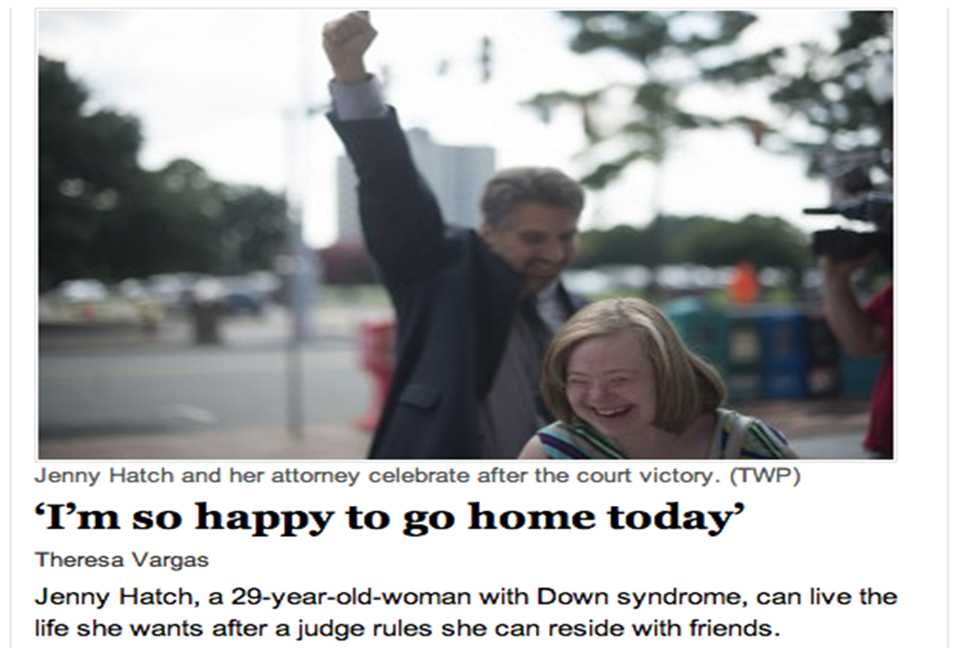
Jenny Got Justice

Slide 35
Why?
Jenny is Strong, Smart, Determined
AND
She had support from:
Friends and professionals
National Organizations and Leaders
Media
A Judge who was willing to Listen and Learn

Slide 36
In Other Words
Jenny Got Lucky

Slide 37
The Lessons Jenny Teaches Us
Justice and Self-Determination should:
NEVER depend on luck or who you know.
ALWAYS Be the Rule NOT the Exception

Slide 38
Where Do We Go From Here?
Why Guardianship?
People may only be ordered into guardianship if they are “incompetent”
“An adult or emancipated minor who lacks sufficient capacity to manage the adult's own affairs or to make or communicate important decisions concerning the adult's person, family, or property” – GSA 35A-1101
AND
“the clerk determines that the nature and extent of the ward's capacity justifies ordering a limited guardianship” - GSA 35a-1212

Slide 39
Think About It:
“Competence” and Making Decisions
People may be able to make some decisions but not others.
Or be able to manage some “important areas” only with assistance.
Or “need supervision” unless they get assistance understand the decisions they have to make
- e.g., Salzman, 2010
Capacity to take medication is not the same as capacity to prescribe it!

Slide 40
Think About It: Self Determination is in People’s Best Interests
Older adults with more self-determination have improved psychological health including better adjustment to increased care needs.
- O’Connor & Vallerand, 1994
People with disabilities who exercise greater self-determination have a better quality of life, more independence, and more community integration.
- Powers et al., 2012; Shogren, Wehmeyer, Palmer, Rifenbark, & Little, 2014; Wehmeyer and Schwartz, 1997; Wehmeyer & Palmer, 2003

Slide 41
So: Ask a Question
If people can make some or all decisions, with assistance or support, are they “incompetent”?

Slide 42
And Ask Another
If people can make some or all decisions, with assistance or support, is guardianship in their “best interests?”

Slide 43
Which Means:
Ask THE KEY Question
When working with people in guardianship or considering guardianship:
What Else Have You Tried?

Slide 44
Where Do We Go From Here:
The Olmstead Issue
Unjustified institutionalization:
“diminish[es] … everyday life activities … including family relations, social contacts, work options, economic independence, educational advancement, and cultural enrichment”
Olmstead vs. L.C., 527 U.S. at 600-01

Slide 45
Common Guardianship Problems
Guardian has the power to make decisions in areas where the person can make their own decisions
Guardian didn’t listen to the person
Guardian doesn’t consider the person’s preferences
Guardian makes decisions they’re not supposed to make -what the person can do during the day, who they can visit, where they can go, etc
Isn’t that “Unjustified Isolation?”
- Hatch, Crane, and Martinis, 2015

Slide 46
As the National Guardianship Association Says
“Alternatives to guardianship, including supported decision making, should always be identified and considered whenever possible prior to the commencement of guardianship proceedings, and the supported decision-making process should be incorporated as a part of the guardianship if guardianship is necessary.”
- National Guardianship Association Position Statement on Guardianship, Surrogate Decision Making and Supported Decision Making, 2015

Slide 47
Supported Decision-Making Can Help People
Understand information, issues, and choices;
Focus attention in decision-making;
Weigh options;
Ensure that decisions are based on their own preferences
Interpret and/or communicate decisions to other parties.
- Salzman, 2011

Slide 48
It’s A Paradigm, Not A Process
There is no “one size fits all” method of Supported Decision-Making.
Can include, as appropriate
Informal support
Written agreements, like Powers of Attorney, identifying the support needed and who will give it
Formal Micro-Boards and Circles of Support
- Martinis, Blanck, and Gonzalez, 2015

Slide 49
It’s A Commitment
ALL forms of Supported Decision-Making recognize:
That EVERYONE has the Right to Make Choices to the maximum of their ability;
That people can get help exercising their Right to Make Choices without giving it up; and
There are as many ways to get help as there are people. Find the one that works for each person!
e.g., Dinerstein, 2010

Slide 50
It Happens

Slide 51
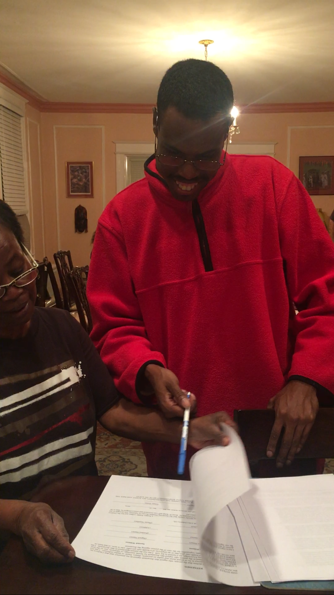
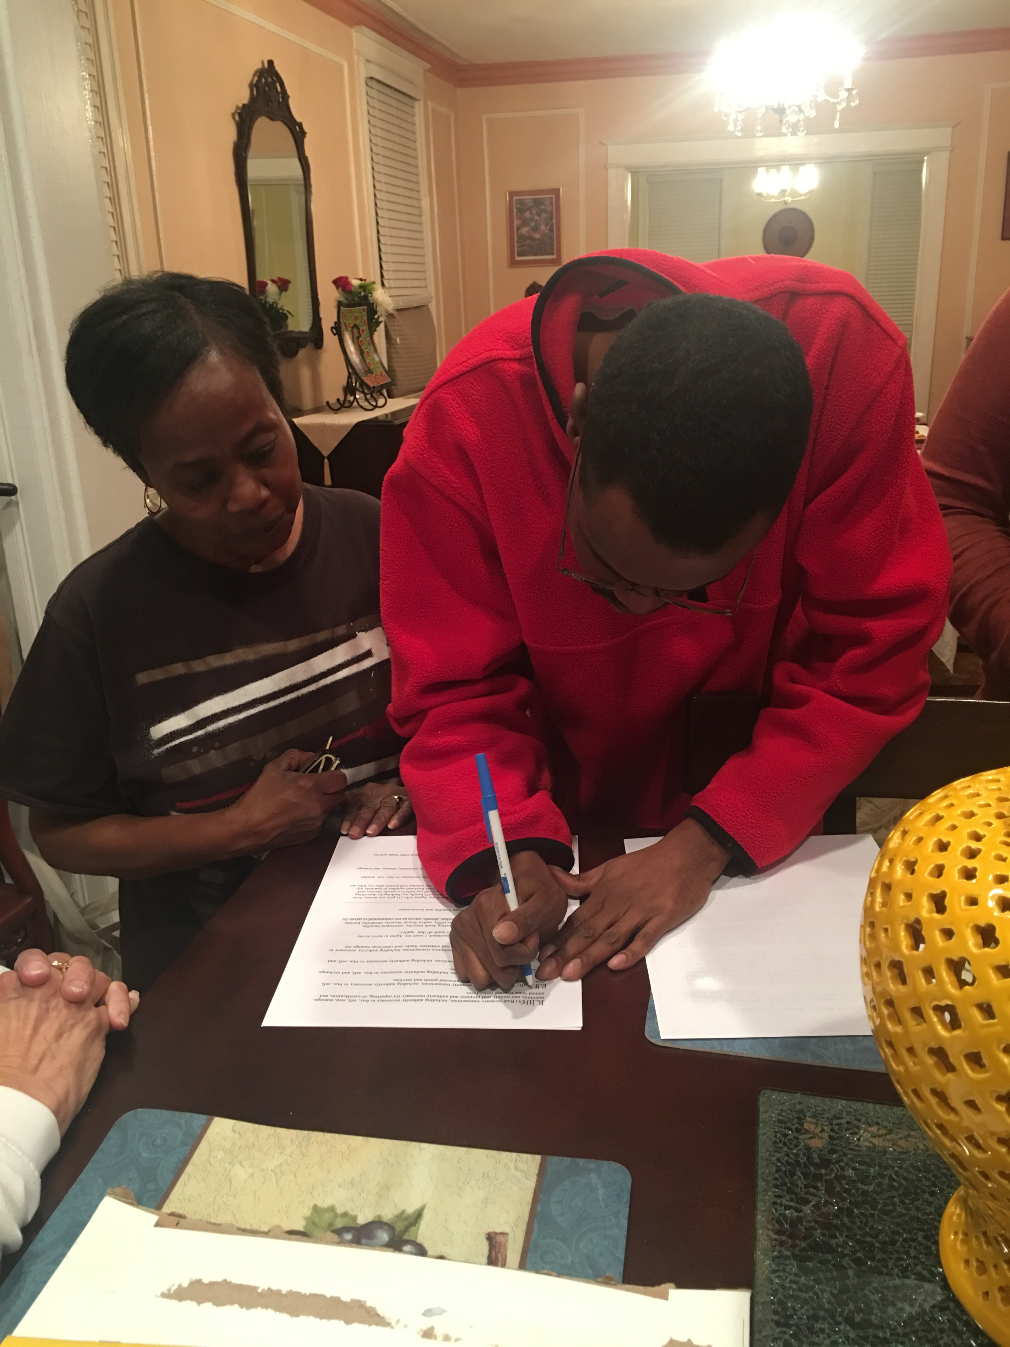
IT IS HAPPENING

Slide 52
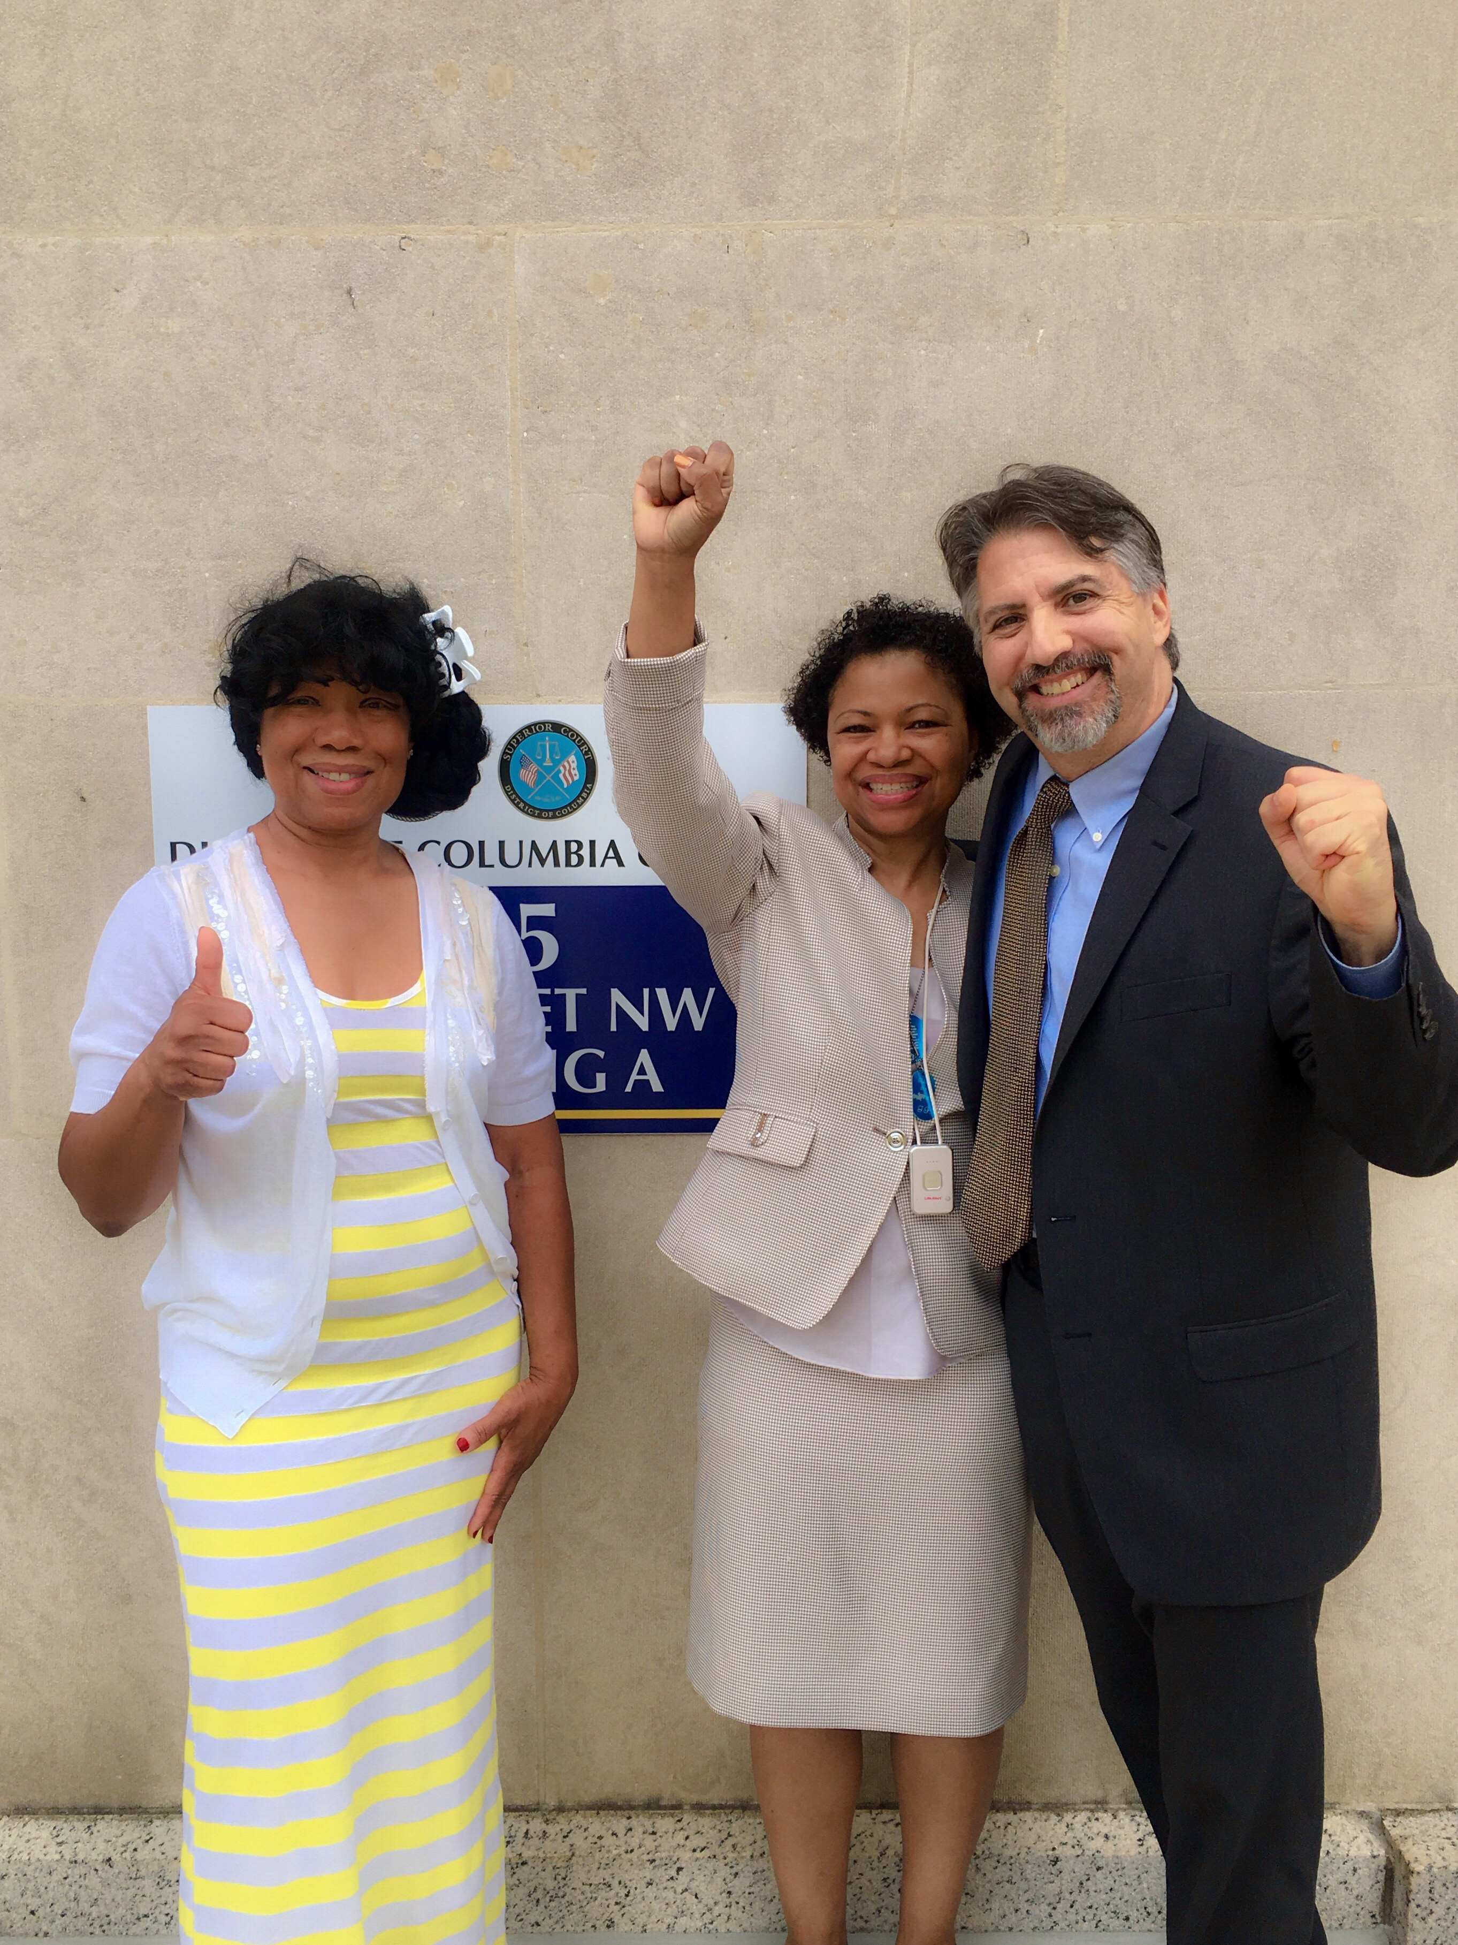
It CAN HAPPEN

Slide 53
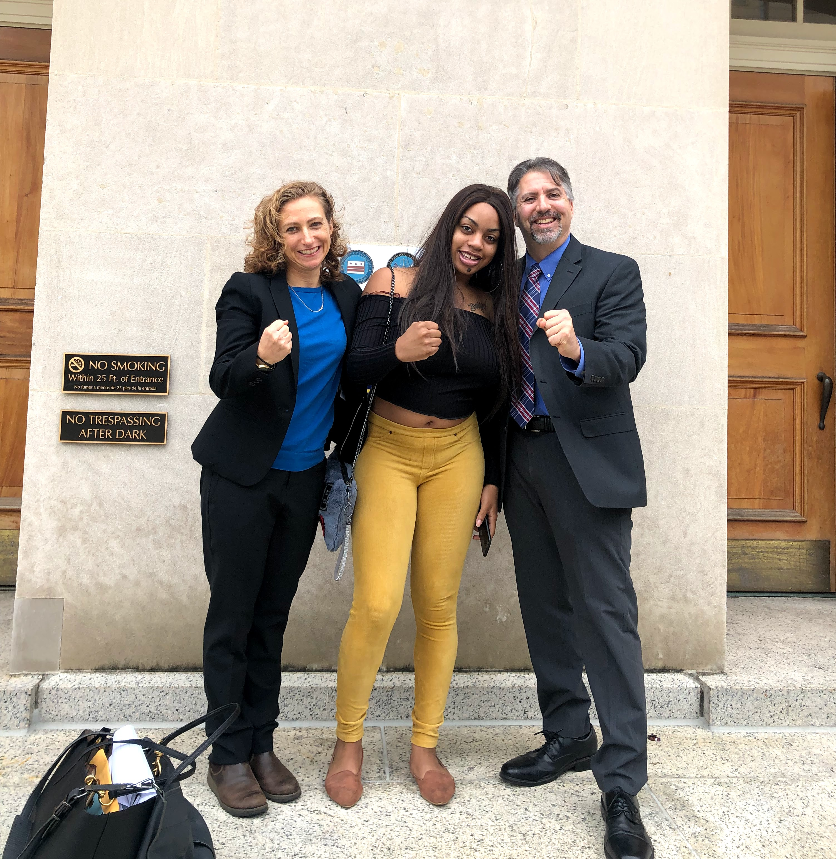
IT DOES HAPPEN

Slide 54
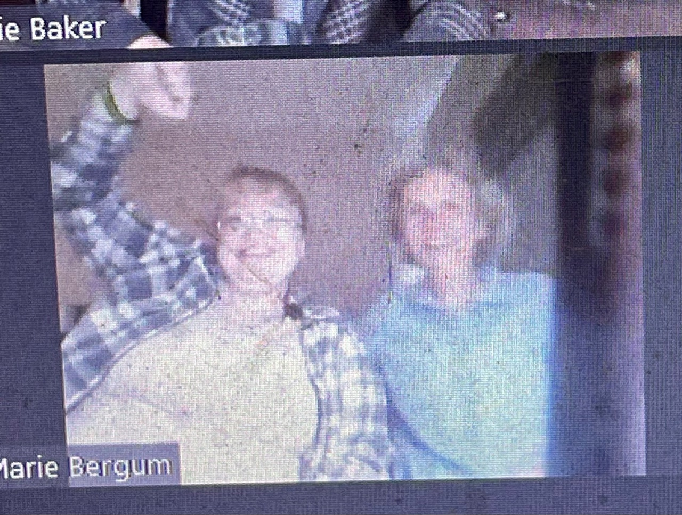
It’s STILL Happening

Slide 55
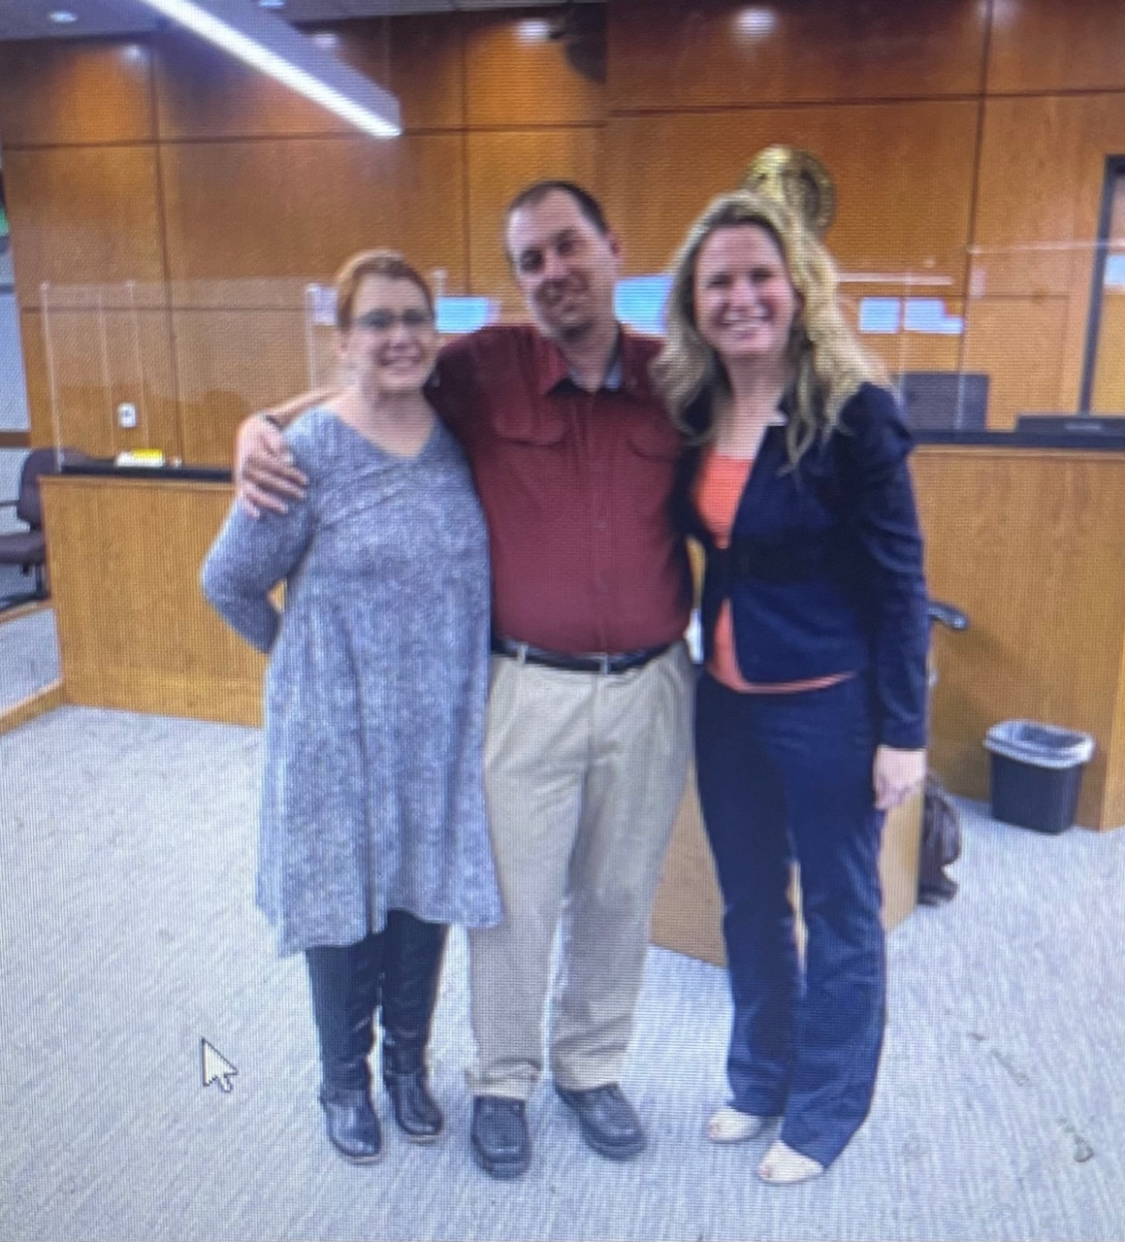
It WILL Keep happening

Slide 56
It’s Happening Across the United States
Laws in 23 states and the District of Columbia recognizing/empowering Supported Decision-Making
National Resource Center for Supported Decision-Making – www.SupportedDecisionMaking.Org
Projects in across the US on increasing access to Supported Decision-Making

Slide 57
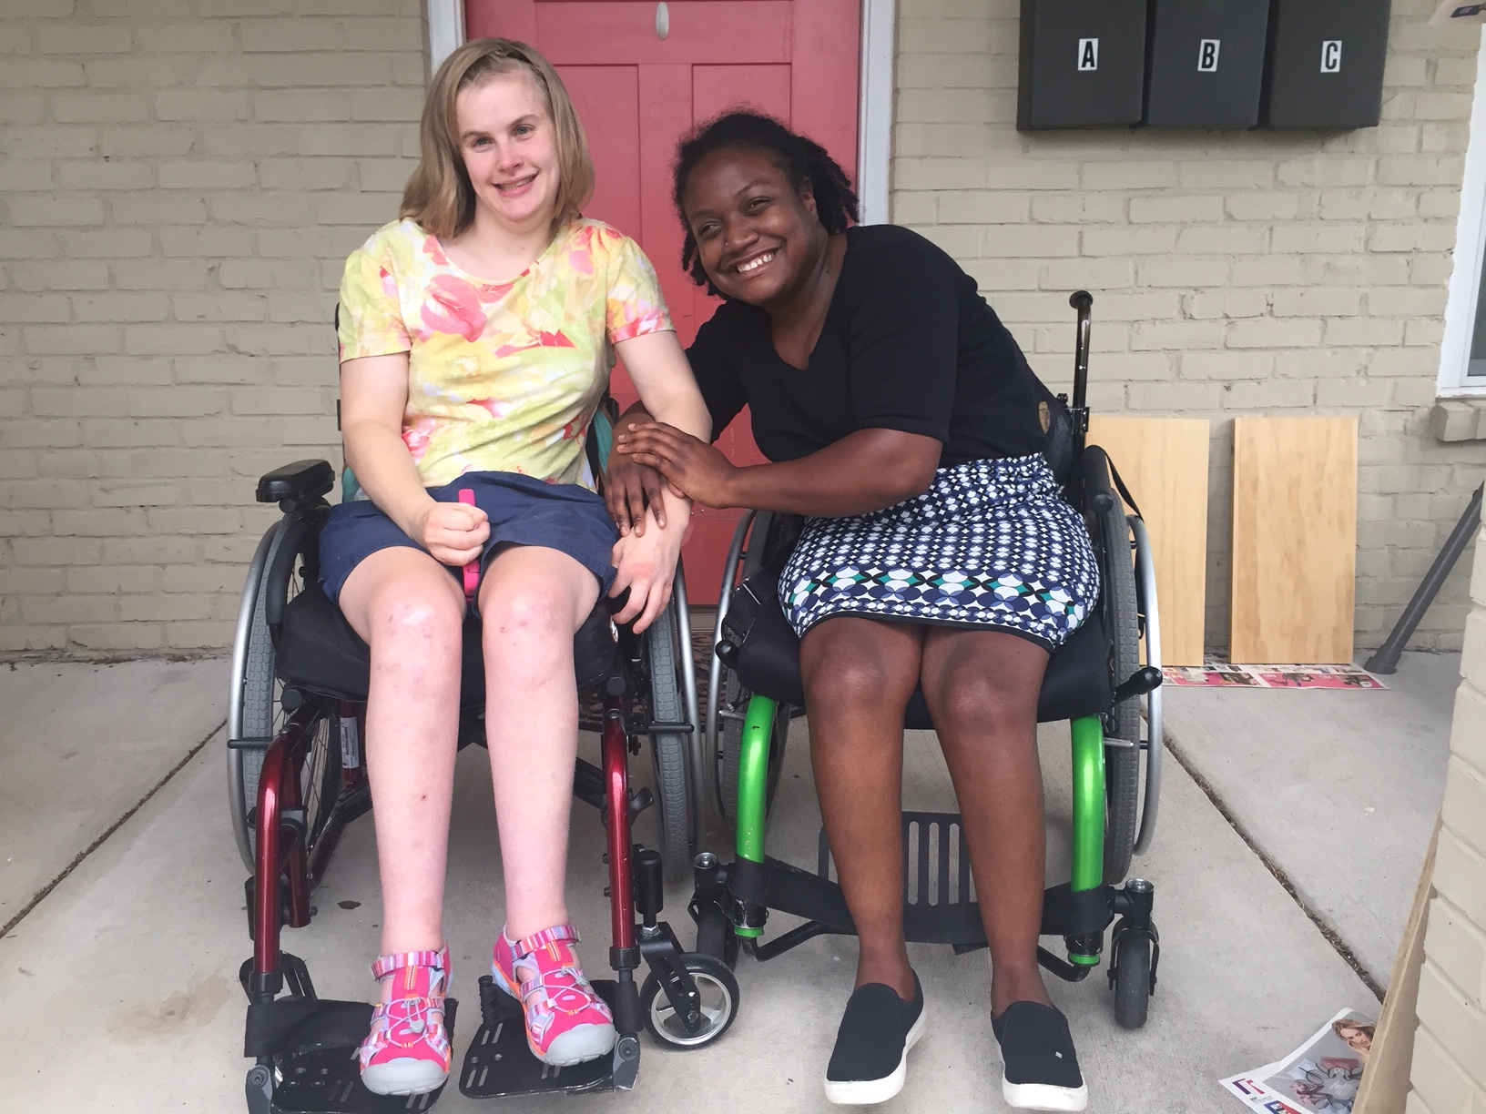
It’s Happening in North Carolina!
“Living on their own for two years together, Suvya & Janie have figured out who can help most effectively with what. It is incumbent on people supporting these women to push them to make their own decisions when it is clearly in their power. This does not mean they will always get it right, but without stretching the muscles, there is no growth. This has clearly led to less asking, more acting, and greater self-determination.”
*Shared by Janie’s mother Betsy MacMichael, Executive Director, First in Families of NC

Slide 58

It’s Happening Across North Carolina
Rethinking Guardianship NC https://rethinkingguardianshipnc.org/
Provides information and resources about Supported Decision-Making and other alternatives to guardianship in North Carolina.
Includes tools and materials to help people understand, make, and communicate decisions in health care, financial planning, and other life areas

Slide 59
It Helps!
“Supported Decision-Making has the potential to increase the self-determination of older adults and people with disabilities, encouraging and empowering them to reap the benefits from increased life control, independence, employment, and community integration”
- Blanck & Martinis, 2015

Slide 60
Research
In a study, young adults who used Supported Decision-Making showed:
Increased independence, confidence, and decision-making abilities
Made better decisions
Had enhanced quality of life
Martinis & Beadnell, 2021
http://supporteddecisionmaking.org/node/488

Slide 61
The Elephant In The Room: Safety
NOTHING: Not conservatorship, Not Supported Decision-Making is 100% "Safe."
HOWEVER: Supported Decision-Making Increases Self-Determination (Blanck & Martinis, 2015), which is correlated with increased Safety (Khemka, Hickson, & Reynolds, 2005).

Slide 62
SDM Will ONLY HAPPEN
If we recognize, respect, and protect EVERYONE’S
Right to Make Choices.

Slide 63
And if We Remember
Opportunities for SDM are All Around Us!
The Student Led IEP
Informed Choice in Vocational Rehabilitation
Person Centered Planning
Financial Management
Life Planning

Slide 64
Join the Conversation
National Resource Center for Supported Decision-Making:
SupportedDecisionMaking.Org
Rethinking Guardianship NC https://rethinkingguardianshipnc.org/
Jonathan Martinis, Senior Director for Law and Policy: JGMartin@Syr.Edu

