Slide 1
Supported Decision-Making From Theory to Practice Creating Coordinated Service Systems
Jonathan Martinis
Jonathan Gerald Martinis, LLC
JGMartinisLLC@Gmail.Com

Slide 2
Article of Faith: EVERYONE has the Same Goal
We ALL want “a foundation that will foster a lifetime of opportunity and happiness.”
“Many of the means to achieving those outcomes are the same: enrollment in post-secondary education, vocational training programs, experiencing work, and developing social networks that foster long-term meaningful relationships and opportunity for continued growth.”
- Gustin, 2015

Slide 3
Getting There: Self-Determination
Life control
People’s ability and opportunity to be “causal agents . . . actors in their lives instead of being acted upon”
- Wehmeyer, Palmer, Agran, Mithaug, & Martin, 2000

Slide 4
Benefits of Self-Determination
People with disabilities who exercise greater self-determination have a better quality of life, more independence, and more community integration - Powers et al., 2012; Shogren, et al, 2014

Slide 5
Getting to Self-Determination: Supported Decision-Making
“a recognized alternative to guardianship through which people with disabilities use friends, family members, and professionals to help them understand the situations and choices they face, so they may make their own decisions without the “need” for a guardian.”
- Blanck & Martinis, 2015

Slide 6
Supported Decision-Making and Self Determination
“Supported Decision-Making has the potential to increase the self-determination of older adults and people with disabilities, encouraging and empowering them to reap the benefits from increased life control, independence, employment, and community integration”
- Blanck & Martinis, 2015

Slide 7
Research
In a study, young adults who used Supported Decision-Making showed:
Increased independence, confidence, and decision-making abilities
Made better decisions
Had enhanced quality of life
Martinis & Beadnell, 2021
http://supporteddecisionmaking.org/node/488

Slide 8
How Did You Get To Self-Determination?
If you’re a person without disabilities, how did YOU
Develop short/long term goals
Identify opportunities
Complete college applications
Write a resume
Get a job
“Most likely all of these experiences happened with support, either from your family or mentors.”
Gustin, 2015

Slide 9
A Critical Difference
People without disabilities: “students . . . and families typically navigate with the assistance of a guidance department and the parent’s personal experience”
People with disabilities: “Figuring out who the different service provider representatives are and what their roles are can take on a life of its own that often overwhelms families, mostly because the different service systems are not always clear on what their roles are or get into territorial role definitions that impact forward progress and planning.”
- Gustin, 2015

Slide 10
The Problem: Lack of Coordination
The “fragmented system of services . . . contributing to the failure . . . to prepare [people with disabilities] for the future.” - Katsiyannis, deFur, & Conderman, 1998
“Too often, systems serving [people] with disabilities operate in “silos,” focused only on what they provide and unaware of what others do. Worse, some providers engage in territorial “battles” that duplicate or cancel out others’ efforts.” – Gustin & Martinis, 2016 www.ApostropheMagazine.Com

Slide 11
Think About It
Special Education, Vocational Rehabilitation, Medicaid Waivers, Mental Health Services, Adult Services
ALL can address
Education
Independent Living
Health Care
Community Integration
SO WHY ARE THEY NOT MORE COORDINATED?

Slide 12
The Solution: Create Coordinated Support Systems
“We must create cultural change by moving away from separation and silos. Instead, individuals, families, and providers must work together to empower people with disabilities to live independent, productive, and community-included lives.”
- Gustin & Martinis, 2016

Slide 13
How It Looks

Slide 14
Opportunities For SDM and Coordinated Support Are All Around Us
Education: “Student Led” IEPs
Employment: “Informed Choice” in Vocational Rehabilitation
Medical Care: Person Centered Planning for Medicaid and Waivers
Adult Services: Centers for Independent Living PASS plans, ABLE Accounts

Slide 15
Getting There: The Individuals with Disabilities Education Act
Purpose of the IDEA:
“to ensure that all children with disabilities have available to them a free appropriate public education that emphasizes special education and related services designed to meet their unique needs and prepare them for further education, employment, and independent living.”
20 U.S.C. § 1400(d)(1)(A) (emphasis added).

Slide 16
Therefore
Self determination is the ultimate goal of education - Halloran, 1993
Promoting self-determination is a special educational “best practice” - Wehmeyer & Hughes, 1998
Schools should focus on improving students’ ability to set goals, solve problems, make decisions and advocate for themselves and, just as importantly, to give students the opportunity to exercise these skills. - Wehmeyer & Gragoudas, 2004

Slide 17
And Yet The “Default Option”
The “School to Guardianship Pipeline” – National Council on Disability, 2019
School personnel are the most frequent source of recommendations that parents seek guardianship/conservatorship - Jameson, et al, 2015
School personnel recommending guardianship/conservatorship often don’t discuss alternatives like SDM with parents – Jameson, et al., 2015

Slide 18
Shut Down the On Ramp
Effective Special Education Advocacy MUST focus on Self-Determination.
Self-Determination and Decision-Making should be written into IEPs AS SOON AS POSSIBLE.
DC Public Schools includes it in
pre-K!

Slide 19
District of Columbia Public Schools
Teaches students as young as 3 to use SDM and “build networks of support . . . to ensure that they are familiar with the process and utilize it in day to day activities.” Sets an important precedent and pattern.
Works with parents to help them “extend skills related to building supportive networks.”
Parents can then help students understand “it is fine to advocate for supports and seek assistance if questions arise.”
- Downing-Hosten, P., 2015

Slide 20
Self-Determination and SDM: Make it a Goal
IEP goals/objectives related to self-determination:
For every goal, there should be an application of self-determination to get there.
“I statements” in IEP goals and objectives to get student involvement and accountability

Slide 21
Self-Determination Goals
Research shows that creating and implementing goals and supports focused on self-determination results in students becoming more self-determined and improving their performance in school and non-school activities. - Wehmeyer, M., Palmer, S., Shogren, K., Williams-Diehm, K., & Soukup, J, 2013

Slide 22
Creating and Reaching Goals: The Student Led IEP
THE STUDENT actually engages in self-determination
THE STUDENT can practice different decision-making methods in a “safe environment”
THE STUDENT leads meeting
THE STUDENT Identifies goals and objectives with assistance from professionals and people THE STUDENT invites

Slide 23
Doesn’t That Sound Like
SUPPORTED DECISION-MAKING

Slide 24
Coordination Opportunity:
SpEd Transition Services
Transition services are “a coordinated set of activities”
To “facilitate the child’s movement from school to post-school activities, including post-secondary education, vocational education, integrated employment (including supported employment), continuing and adult education, adult services, independent living, or community participation;”
Are “based on the individual child’s needs, taking into account the child’s strengths, preferences, and interests; and
Include “instruction, related services, community experiences, the development of employment and other post-school adult living objectives, and, when appropriate, acquisition of daily living skills and functional vocational evaluation.”
20 USC 1401(34)

Slide 25
Transition Services
Start: “Beginning not later” than the year the student turns 16 - 20 U.S.C. § 1414(d)
14 in NC!
Continue: At least until student is 21 - 34 CFR §300.101

Slide 26
YOU HAVE SEVEN YEARS
To coordinate services”
To coordinate community experiences
To coordinate the development of post-school adult living objectives
To coordinate . . . the acquisition of daily living skills
To prepare for further employment, education, and independent living

Slide 27
Coordinated Support Opportunity:
Vocational Rehabilitation
VR program provides services and supports to help people with disabilities:
“prepare for, secure, retain, advance in, or regain employment”
Rehabilitation Act, 2006, § 722 (a)(1)

Slide 28
What If…
The skills you need to work are the SAME ones you need to build self-determination and avoid guardianship?
Self-care
Organization
Communication
Interpersonal Skills

Slide 29
Employment Based Skills?
Would YOU hire or retain someone who has difficulty:
Following directions or staying on task?
Communicating with you or your customers?
Getting along with co-workers?

Slide 30
Therefore
If these “life skills” limitations are related to a person’s disability and make it harder for him or her to prepare for, get, or keep work:
VR MUST PROVIDE SERVICES AND SUPPORTS TO HELP OVERCOME THEM

Slide 31
Eligibility For VR
Your are eligible for VR if you
Have a disability
Want to Work
AND
VR services will help you work.
If you receive SSI/SSDI you are presumed eligible!
34 CFR 361.42
NC Division of Vocational Rehabilitation Services: https://www.ncdhhs.gov/divisions/vocational-rehabilitation-services

Slide 32
Make A Plan
The Individualized Plan for Employment (IPE)
Lays out the PERSON’S employment goal – the job the PERSON wants to get – and he services the PERSON chooses to get there.
34 CFR 361.46

Slide 33
VR Can Cover A LOT
Some services that are available:
Assessments
Counseling
Job search and retention services
Assistive technology
Medical and mental health care
Education Expenses (including College)
On the job training
Job coaches
Transportation
“Maintenance” payments
Interpreters
Services to family members (like Day Care!)
34 CFR 361.48

Slide 34
Support is Built-In
VR Agencies must ensure that the person can exercise “informed choice”
“Informing each applicant and eligible individual . . . through appropriate modes of communication, about the availability of and opportunities to exercise informed choice, including the availability of support services for individuals with cognitive or other disabilities who require assistance in exercising informed choice throughout the vocational rehabilitation process”
- 34 C.F.R. 361.52

Slide 35
Doesn’t That Sound Like…
Supported Decision-Making?
The Student-Led IEP?

Slide 36
Coordination Opportunity: Pre-Employment Transition Services
Pre-ETS are available for ALL students with IEPs or 504 Plans
Pre-ETS include: :
Job exploration counseling;
Work-based learning experiences, which may include in-school or after school opportunities, or experience outside the traditional school setting (including internships), that is provided in an integrated environment in the community to the maximum extent possible;
Counseling on opportunities for enrollment in comprehensive transition or postsecondary educational programs at institutions of higher education;
Workplace readiness training to develop social skills and independent living; and
Instruction in self-advocacy (including instruction in person-centered planning), which may include peer mentoring (including peer mentoring from individuals with disabilities working in competitive integrated employment).
VR MUST COME TO IEP MEETINGS IF INVITED
- 34 CFR 361.48

Slide 37
“Person Centered Planning”
Person Centered Plan MUST:
Address “health and long-term services and support needs in a manner that reflects individual preferences and goals.”
Result “in a person-centered plan with individually identified goals and preferences, including those related community participation, employment, income and savings, health care and wellness, education and others.”
https://www.medicaid.gov/medicaid/hcbs/downloads/1915c-fact-sheet.pdf

Slide 38
Person Centered Planning Focuses On
What is:
Important TO the Person
Important FOR the Person
Where the Person is and where the Person wants to be
What needs to change and what needs to stay the same to get there

Slide 39
Doesn’t That Sound Like…
Supported Decision-Making?
The Student Led IEP?
Informed Choice in VR?

Slide 40
SDM, Power of Attorney, And Financial Authority
I will not buy, sell, manage, or otherwise take or exercise any interest in any tangible property or item costing or worth more than $X without my agent’s agreement. For example, if I want to buy or sell a car for $20,000, I would need my agent to agree or the sale could not go through.
In making decisions whether or not to buy, sell, manage, or otherwise take or exercise any interest in any tangible property or item costing or worth more than X, my agent and I will discuss the situation and give consideration to my express wishes before my agent decides whether or not to agree.

Slide 41
SDM, Power of Attorney And Banking
I agree that my agent will be listed as a joint account holder on all bank or other financial institution accounts – including checking and savings accounts, as well as credit and debit cards – that I have or open while this power of attorney is in effect.
I agree that I will not withdraw more than $X from any account, write a check for more than $X, or otherwise cause more than $X to be withdrawn from or charged to any account unless my agent agrees.
In making decisions whether or not to agree to write checks, withdraw money from my accounts or charge money to my accounts, my agent and I will discuss the situation and give consideration to my express wishes before my agent decides whether or not to agree.

Slide 42
A Real Problem
“[P]eople with disabilities cannot have a decent quality of life with limited financial resources and modest government support.”
Forbes Magazine, “Are Tax-Free ABLE Accounts The Right Financial Solution for People with Disabilities,” 12/4/14

Slide 43
When You Receive Public Benefits
To live independently, many people rely on public benefits like Medicaid, SSI, and SSDI
To qualify for Medicaid/SSI, you generally may not have more than $2,000 of countable assets. Earnings of more than the substantial gainful activity (SGA) level can also affect eligibility for these programs.
If families provide financial or “in-kind” support, the person may be disqualified or have benefits reduced.

Slide 44
Enter ABLE
Achieving a
Better
Life
Experience

Slide 45
What It Is
Like 529 Accounts for Education
Family, friends can contribute up to $15,000 per year into an ABLE account
ABLE account money can be withdrawn, tax free, to pay for housing, transportation, healthcare and other expenses
Money in an ABLE account does not affect eligibility for Social Security or Medicaid/Medicare (if there is more than $101,999 in account, SSI benefits will be suspended, but still receive Medicaid).
NC ABLE accounts https://savewithable.com/nc/home.html
ABLE National Resource Center: www.ablenrc.org

Slide 46
Specifically
ABLE Account funds can be used for:
Education—including tuition for preschool thru post-secondary education, books, supplies, and educational materials related to such education, tutors, and special education services.
Housing—including rent, mortgage payments, home improvements and modifications, maintenance and repairs, real property taxes, and utility charges.
Employment Support—including expenses related to obtaining and maintaining employment, including job-related training, assistive technology, and personal assistance supports.
Health—including premiums for health insurance, medical, vision, and dental expenses, habilitation and rehabilitation services, durable medical equipment, therapy, respite care, long term services and supports, and nutritional management.
Transportation—including the use of mass transit, the purchase or modification of vehicles, and moving expenses.
Other Life Necessities—including clothing, activities which are religious, cultural, or recreational, supplies and equipment for personal care, community-based supports, communication services and devices, adaptive equipment, assistive technology, personal assistance supports, financial management and administrative services, expenses for oversight, monitoring, or advocacy, funeral and burial expenses.

Slide 47
ABLE Accounts and Self-Determination
In ABLE Accounts, the person with disabilities decides how the money is spent

Slide 48
Doesn’t That Sound Like a Job For
Supported Decision-Making:
“[P]eople with disabilities use friends, family members, and professionals to help them understand the situations and choices they face, so they may make their own decisions without the “need” for a guardian.”
- Blanck & Martinis, 2015

Slide 49
Bringing It Together
Use Supported Decision-Making across systems to Identify and Coordinate
Opportunities and Options
Supporters and Teams
Goals, Supports, and Services

Slide 50
Creating A Coordinated Support Plan
Review! Go through each area of the individual's life.
Example: Financial, Medical, Social, Employment
Brainstorm! Does the person need support in these areas?
If so, talk about what support could help, who could provide it, and how
Write! As you develop support solutions, create a written plan for the person and team to use
Attach! Include it as part of the person’s IEP, ISP, IPE, and other plans

Slide 51
Making It Happen: Dream-Inspired Planning
Coordinating and collaborating to create support plans that build on the person’s dreams.
Goals and Objectives are created by working with the person to identify their dreams, the values that make them up, and the education, employment, independent living, and other goals that match up to them

Slide 52
Dream-Inspired Planning: Three Steps
Dream: The person identifies and communicates his/her dreams
Dig: Conversations between the person and the support coordinator about his/her dreams, the values and visions that make them up, and the implications of them
Develop: The person and support coordinator develop program goals and objectives that are consistent with and move the person toward their dreams

Slide 53
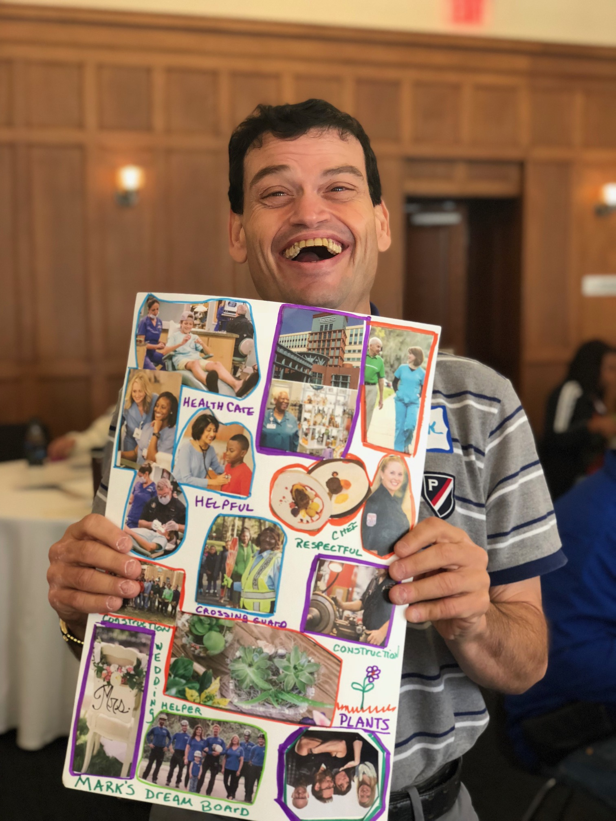
Dreaming

Slide 54
It Can Happen: Project RENEW
Provided young adults with coordinated services including employment planning and training as well as education in independent living skills and social skills- Malloy, 2013.
First year of program
93% of participants found employment
69% maintained employment for more than 6 months
2 years after program
94% either completed high school or were involved in a high school program
75% were enrolled in post-secondary education
83% found employment
- Hagner, Cheney, & Malloy, 1998

Slide 55
It IS Happening Pickaway County and Perry County, Ohio and Rutland, Vermont
Collaboration between School, VR, and Medicaid Waiver provider
Identifying students at risk of guardianship and putting supports in place to help them live independently
School, Board, and VR meet with student and parents to create joint plans with common goals and objectives
In the meetings, they student, family, and agencies, choose supports and services and who is best to implement them

Slide 56
CCS Results: Ohio
Mansfield Senior High School in Ohio encouraged 30 students to create Dream Boards to share their dreams with their teachers and counselors. Two teachers commented on the experience:
It was a wonderful opportunity for our special needs students. The level of engagement by every student in our program was incredible. Equally terrific was for our staff to hear and share in our students' dreams and to hear them express their career passions. Many of our staff were brought to tears when we heard what our students shared. We sincerely hope that we can continue to stir and form our students' career dreams. _ Richland County Board of Developmental Disabilities, 2017

Slide 57
CCS Results: Ohio
Two case managers from a local Developmental Disabilities Board “had the opportunity to observe first-hand how powerful the dream boards can be.”
During a home visit with a family, a parent explained her daughter brought home a dream board from school. The parent expressed there were passions on the dream board her daughter shared that she was unaware of. The parent had no idea that her daughter was interested in working at Starbucks - Richland County Board of Developmental Disabilities, 2017.

Slide 58
CCS Results: Ohio
Students using Dream Boards in IEP meetings
“The student shared her dream board with the team and pointed to each picture to describe her dreams. Each item she shared was added to her IEP as these were new things that the student wanted for her future. The student shared her dream job is to be a fashion designer. She had additional dreams of being married, owning a car, making money and to have friends. - Richland County Board of Developmental Disabilities, 2017.

Slide 59
Results: Vermont
High School, VR Agency, and Waiver provider collaborated with students and families
Students made Dream Boards
Agencies created joint plans with common goals and objectives
Plans were implemented and updated as necessary over one year.
After the year, participants were surveyed:
86% Agreed that the Program helped prepare students for life after high school;
73% Agreed that the program was easier than the usual methods
100% Agreed that the Program improved the supports provided to students;
93% Agreed that the Program increased the amount of supports students received;
100% Agreed that the Program helped identify student needs
100% Agreed that the Program provided better supports to meet student needs

Slide 60
But It Will ONLY HAPPEN
If we recognize, respect, and protect EVERYONE’S
Right to Make Choices.

Slide 61
Remember The Challenge
EVERY great advance in civil rights fundamentally changed the way “things have always been”

Slide 62
Remember The Obstacles
Change is HARD
“We were not promised ease. The purpose of life . . . is not ease. It is to choose, and to act upon the choice. In that task, we are not measured by outcomes. We are measured only by daring and effort and resolve.”
- Stephen R. Donaldson

Slide 63
Change the Culture, Change the World!
“[P]eople with disabilities will have the same opportunities for success and security as their nondisabled peers. If we change the culture, we will change the world!”
Gustin & Martinis, 2016

Slide 64
Join the Conversation
The National Resource Center for Supported Decision-Making: SupportedDecisionMaking.Org
Jonathan Martinis: JGMartinisLLC@Gmail.Com

