Slide 1
What & Why of Certification
Sally Hurme, J.D.
North Carolina Guardianship Association
May 2023

Slide 2
Objectives
How certification works
What are its benefits
What’s new at CGC

Slide 3
Certification Goals
Identify qualified guardians/conservators
Increase pool of qualified guardians
Hold guardians to ethical standards of practice
Develop a base of general knowledge
Create uniform appreciation of fiduciary principals
Assist courts with monitoring
Enhance the reputation of the profession

Slide 4
What’s the Difference?
NGA educates
CGC certifies

Slide 5
NGA Roles
Developed Ethical Principals
Developed Standards of Practice
Revised 2022
Develops certification/certificate review materials
Created Fundamentals of Guardianship
Revised 2023
Conducts certification review courses
Conducts continuing education courses required for CGC re-certification

Slide 6
NGA Ethical Principals
1. Treats the person with dignity.
2. Involves the person to the greatest extent possible in all decision making.
3. Selects option that places the least restrictions on the person’s freedom and rights.
4. Identifies and advocates for the person’s goals, needs, and preferences.
5. Maximizes the person’s self-reliance and independence.
6. Keeps confidential the person’s affairs.
7. Avoids conflicts of interest and self-dealing.
8. Complies with all laws and court orders.
9. Manages all financial matters carefully.
10.Respects that the money and property being managed belong to the person.

Slide 7
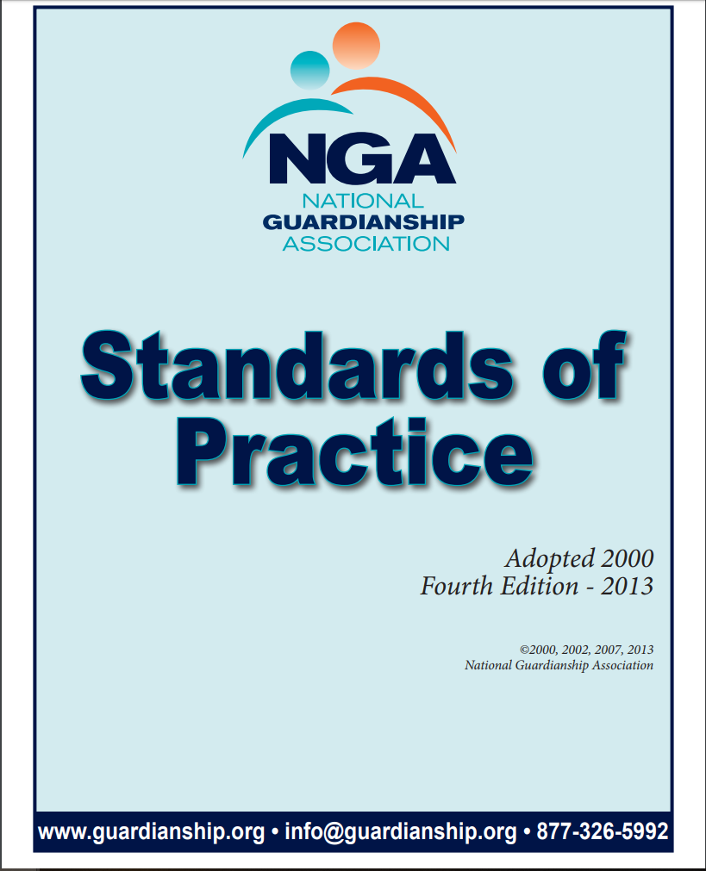
NGA Standards of Practice
At the heart of all we do
Core reference to model behavior
Application of ethical principles
Notes:
Julia

Slide 8
NGA Standards of Practice
Advocate for individual
Protect individual’s rights
Implement least restrictive alternatives
Enhance quality of life
Avoid conflicts of interest
Apply fiduciary principles
Ethically conduct business

Slide 9
NGA Standards of Practice
Basis of questions asked on CGC exam
Application to fact patterns
Standards by which conduct measured
By court
By CGC disciplinary process

Slide 10
National and State Certification
National certification is voluntary
Center for Guardianship Certification
13 states have some form of mandatory certification/licensing
4 states have state process
9 states require professional guardians to be CGC certified
Notes:
Sally

Slide 11
Center for Guardianship Certification
Only national certification board for guardians/conservators
2-tiered system
National Certified Guardian (NCG)
1257 nationwide in 44 states (4/2023)
6 in North Carolina
National Master Guardian (NMG)
55 nationwide in 20 states
1 in North Carolina

Slide 12
25 Years of CGC!
4800 certificants*
* (Since 1997)

Slide 13
Please Rise!

Slide 14
What CGC Certification Means-- More than Just a Test!
Eligible to be appointed
Not disqualified by prior conduct
Pledges to abide by ethical standards
Agrees to submit to disciplinary process
Demonstrates understanding and application of basic guardianship principles guardians in any state should know
Requires ongoing continuing education

Slide 15
National Certified Guardian (NCG)
Notes:
Julia

Slide 16
NCG Eligibility
SSN check
3rd party education check
Criminal background check/fingerprint
Education credits
No felony
Not civilly liable in fraud, misrepresentation
Not removed for cause
No claim against bond
Not disciplined by any licensing/certification entity
Notes:
Education credits
Related college degree 10 ed credits
Related licensure/certification need 20 credits
High school or unrelated degree 30 ed credits

Slide 17
NCG Examination
100 multiple choice questions
Complete within 2 hours
Online at local testing center
Schedule on your own
Sit only after all verifications are in place

Slide 18
Re-Certification
Every 2 years
20 hours continuing education
Reaffirm eligibility and no disqualifying conduct

Slide 19
National Master Guardian (NMG)

Slide 20
NMG Eligibility
Be an NCG
Graduate degree with three (3) years professional guardianship experience
OR Bachelor’s degree with five (5) years experience
OR twelve (12) years experience

Slide 21
Professional guardianship experience
Making decisions (i) as a court-appointed guardian, (ii) as agent for a guardian, or (iii) in a supervisory capacity over a guardian
Serving two or more who unrelated to each other
Spending an average of at least 16 hours/week making decisions during at least 3 of the last 5 years

Slide 22
NMG Experience Narrative: Pick 6 to Explain “Experience”
Train and mentor less experienced guardians.
Provide educational opportunities.
Consult on medical procedures including use of psychotropic medications.
Advance the profession through policy development, legislative action, advocacy or community outreach.
Consult or make decisions on end-of-life issues and other complex or controversial issues.
Actively advocate for limited guardianship, alternatives to guardianship and restoration of rights.
Competence in managing complex issues.
Manage significant financial estates.
Conduct or arrange for comprehensive assessment.
Provide consultation on a wide range of guardianship issues.
Provide supervision to less experienced guardians or staff.
Direct a professional guardianship program.
Experience with more than one disability group.

Slide 23
NMG Examination
120 multiple choice questions within 3 hours
5 out of 7 essay questions within 3 hours
Demonstrate ability to spot and resolve complex issues
Online at local testing center
Can be separate sessions

Slide 24
CGC Discipline
Courts have primary responsibility to supervise guardians and impose sanctions
CGC receives and reviews complaints
Applies disciplinary procedures
Has no investigatory capability

Slide 25
Disciplinary Process
Complaint must be in writing
Must allege Standard violated
Reviewed by legal counsel
Notice to guardian
Opportunity to respond
Appoint Professional Review Board
Paper review or telephonic hearing
Range of sanctions
Appeal to CGC Board

Slide 26
What’s New! CGC Certificates
Notes:
Sally

Slide 27
Finance Certificate
Augments NCG/NMG certification
For those who concentrate on conservatorships
For non-guardians, too

Slide 28
Finance Certificate Process
100- question multiple choice
Online at your home/office
Good for 3 years
NGA study guide

Slide 29
Special Needs Trust Management Certificate
Online in 2022
Developed with Professional Fiduciaries Association of California (PFAC)
PFAC developing review materials portal

Slide 30
Benefits of Certification
What Research Tells Us
Notes:
Julia

Slide 31
Certificants Say …
Top reasons to be certified
Demonstrates my understanding of ethics and standards
Enhances quality of my practice
Greater knowledge of guardianship practices
Brings personal satisfaction
Notes:
Retiring, changing careers
Don’t see the benefit
Too expensive
Hard to get CEUs
Not required

Slide 32
Certificants say….
People take me seriously
Enhances my marketing
Allowed increase in my pay
Required by my agency/my state

Slide 33
Certificants say…
Allows me to be the best I can be
Gives me more credibility as an expert
Gives me standing in dealing with other agencies and legal community
Evidence of my professionalism
Sets a standard for others

Slide 34
Certificants say…
I’m a better guardian
I have greater knowledge about guardian responsibilities
I have increased peer recognition
I have increased judicial recognition

Slide 35
What Courts Say
Notes:
Sally

Slide 36
Methodology
Survey in 2020
Judges in jurisdictions where NCGs and NMGs are located
Online/mail

Slide 37
Courts Say Certification Makes an Impact
guardians’ knowledge concerning their responsibilities (35%)
timely filing of personal status reports (28%)
providing complete information on personal status reports (28%)
knowledge of guardianship procedures (26%)
application of ethical codes/standards of practice (26%)

Slide 38
Courts say Certified Guardians Contribute to Administration of Justice
understanding guardian responsibilities (80%)
complying with guardianship procedures (75%)
demonstrating an understanding of ethical codes/standards of practice (64%)
assisting people under guardianship with complex needs (58%)
managing large and/or complex estates (53%)

Slide 39
4th Summit Recommendation
Recommendation 5.1:
States should regulate court-appointed professional guardians through licensure or certification, or both, with sufficient funding for an agency to implement and oversee licensure and certification and to vet, train, test and discipline these guardians….

Slide 40
Questions

